Slide 1
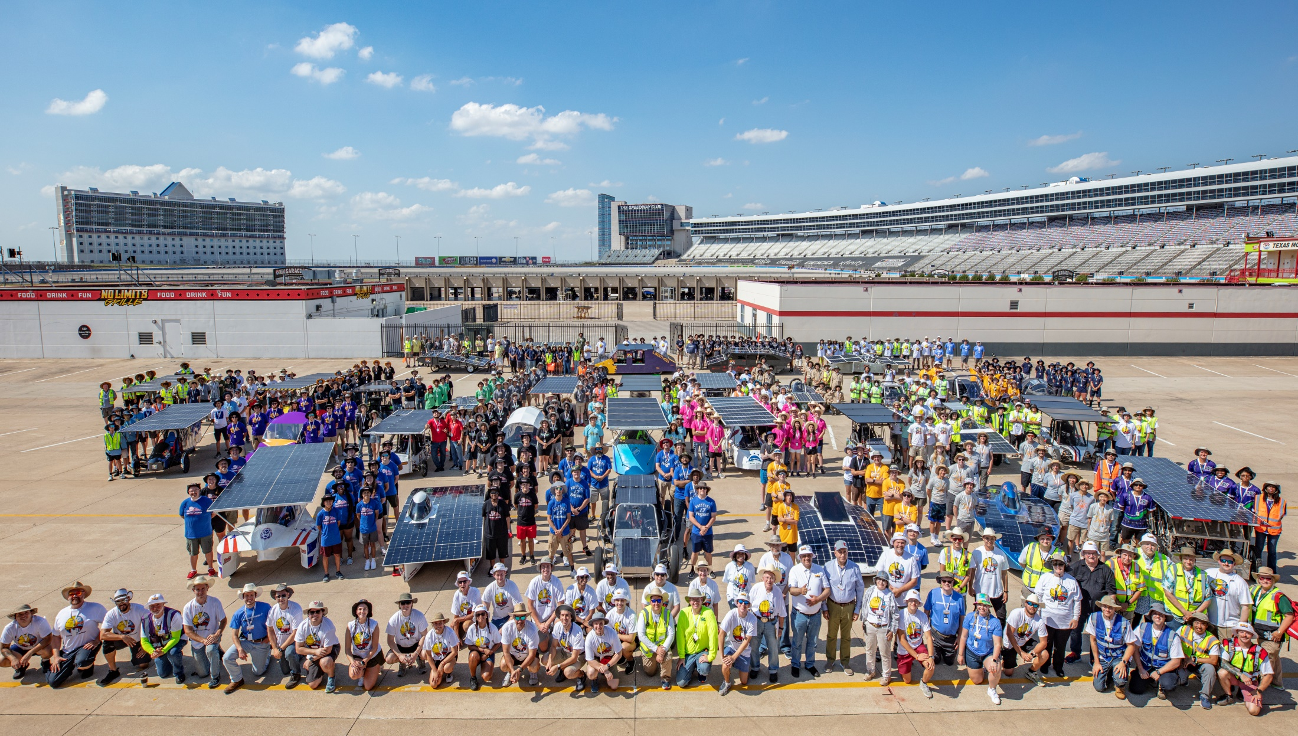
WELCOME TO THE 2025 SOLAR CAR CHALLENGE

Slide 2
Why Participate in the Solar Car Challenge
Problem-Solving and Collaboration
Dedication and Commitment – the
“do not quit” attitude
Project-Based Engineering
Learning to deal with Success and Failure
Learn about Budgets and Public Speaking
Learn the importance of teamwork

Slide 3
AGENDA FOR 2025 (1) January 17-19th - Specialty Workshop (2) January 31st - Deadline for “Intent-to-Race” (3) March 1st - Registration Deadline (4) June 1st - Deadline for Insurance Certificate (5) June 15th - Deadline for Digital Scrapbook (6) July 1st - Deadline for Video of Presentation (7) July 16th - Team Check-In* Everyone taking part must be there! (8) July 17-19th – Scrutineering* (9) July 18-22nd - Cross-Country Race* ______ * Contingent on the Texas Motor Speedway

Slide 4
What’s Emphasized In 2025
Safety Cell / Crush Zones / Roll Bar(s)
New Electric Solar-Powered Division Rules
(1) Increased battery packs capacity to 5.25 kWhr
(2) Increased Solar Array Panel to 2.5 kW
(3) No maximum dimensions! Classic Division guidelines apply.
Registration Packets must be complete, and arranged so that judges can identify data
Forever Miles increased to 25
In-person Questions during Scrutineering

Slide 5
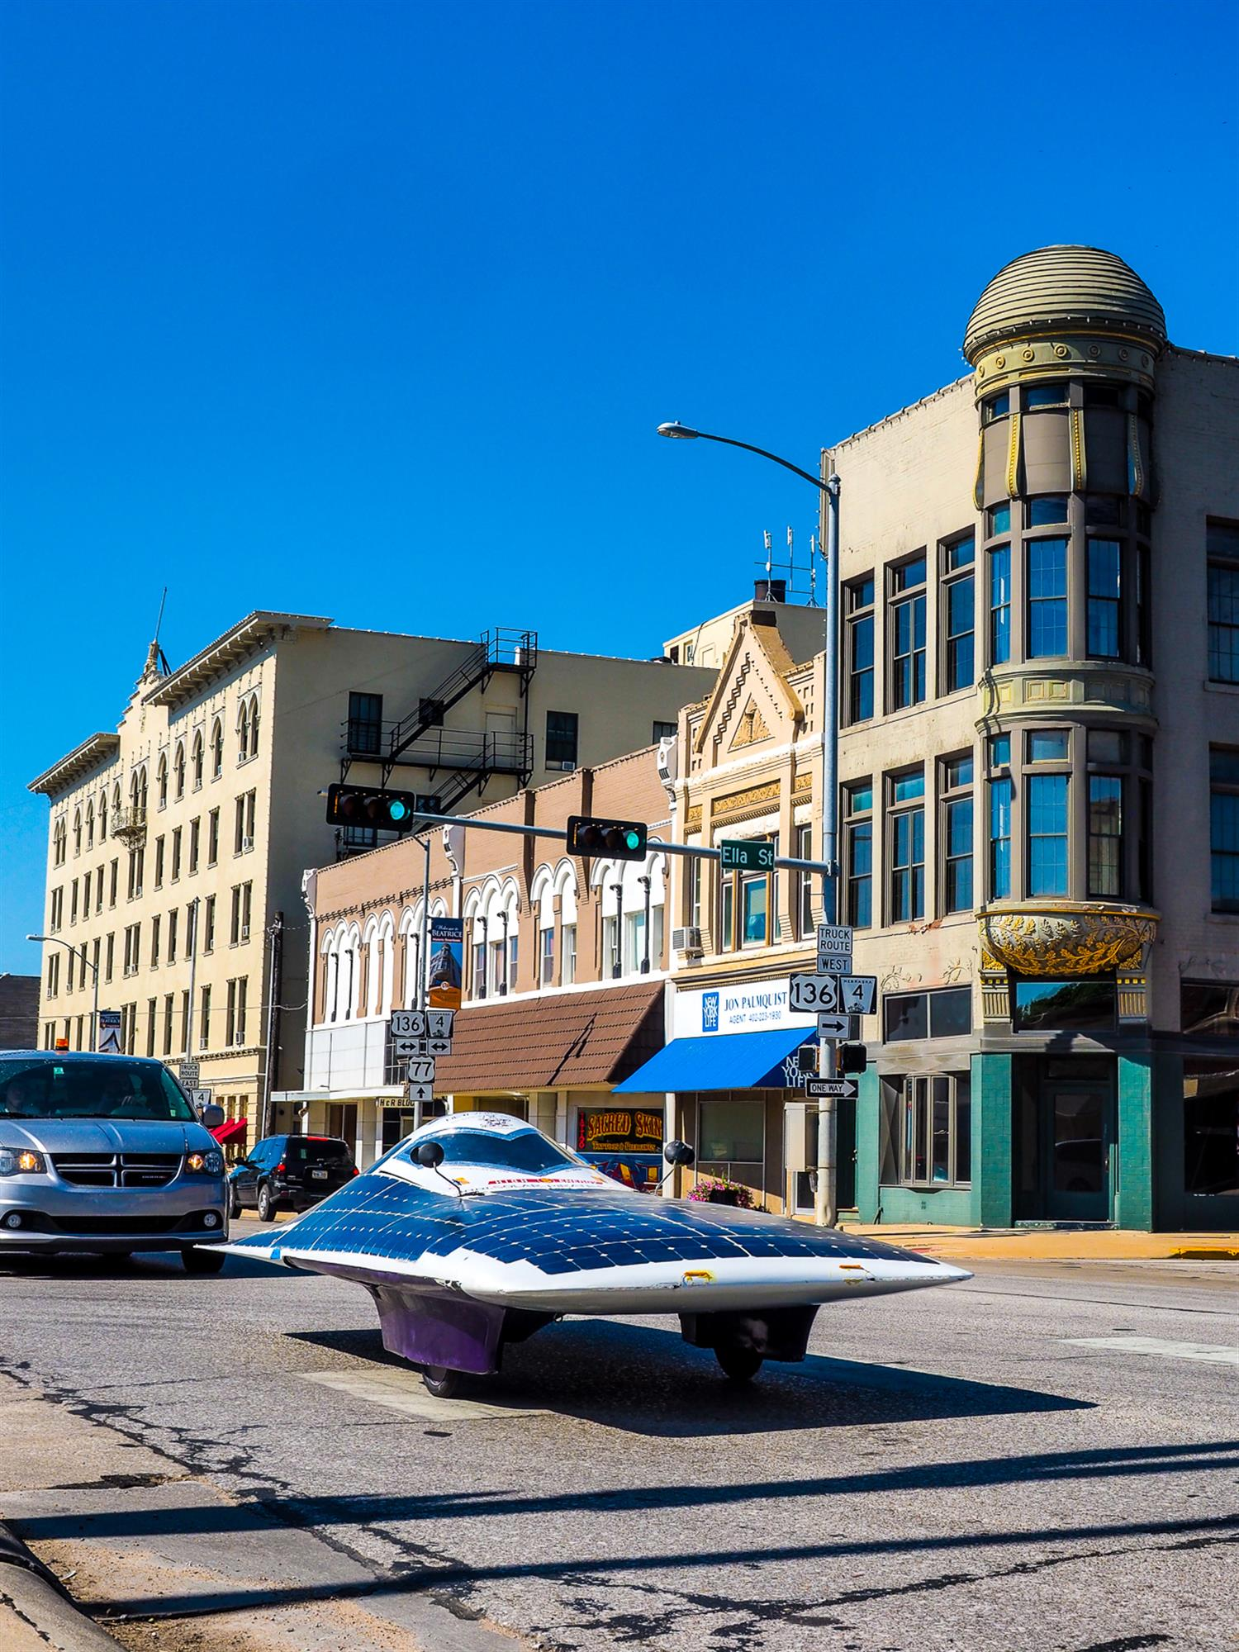
Now, it’s time to start preparing for the 2025 Solar Car Challenge

Slide 6
What is our Philosophy?

Slide 7
This is a Cooperation rather than a Competition

Slide 8
Where do we start?

Slide 9
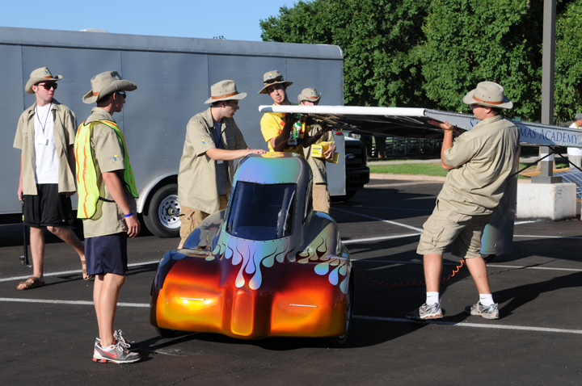
Start with Team-Building

Slide 10
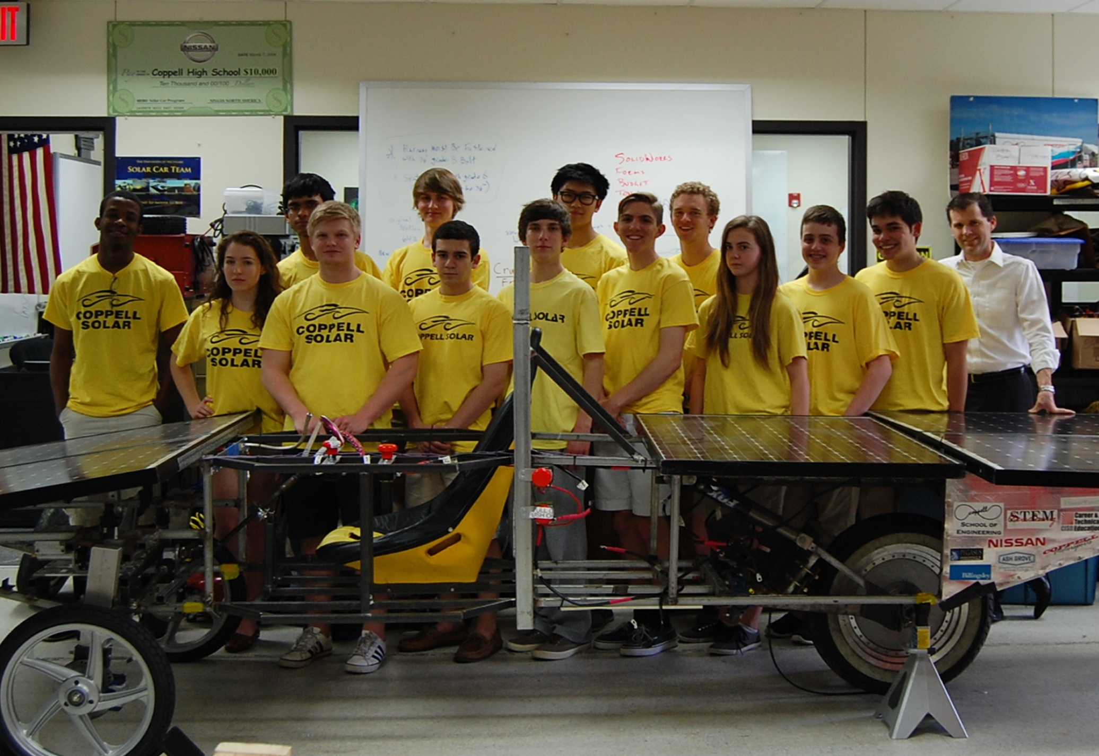
How BIG a team?

Slide 11
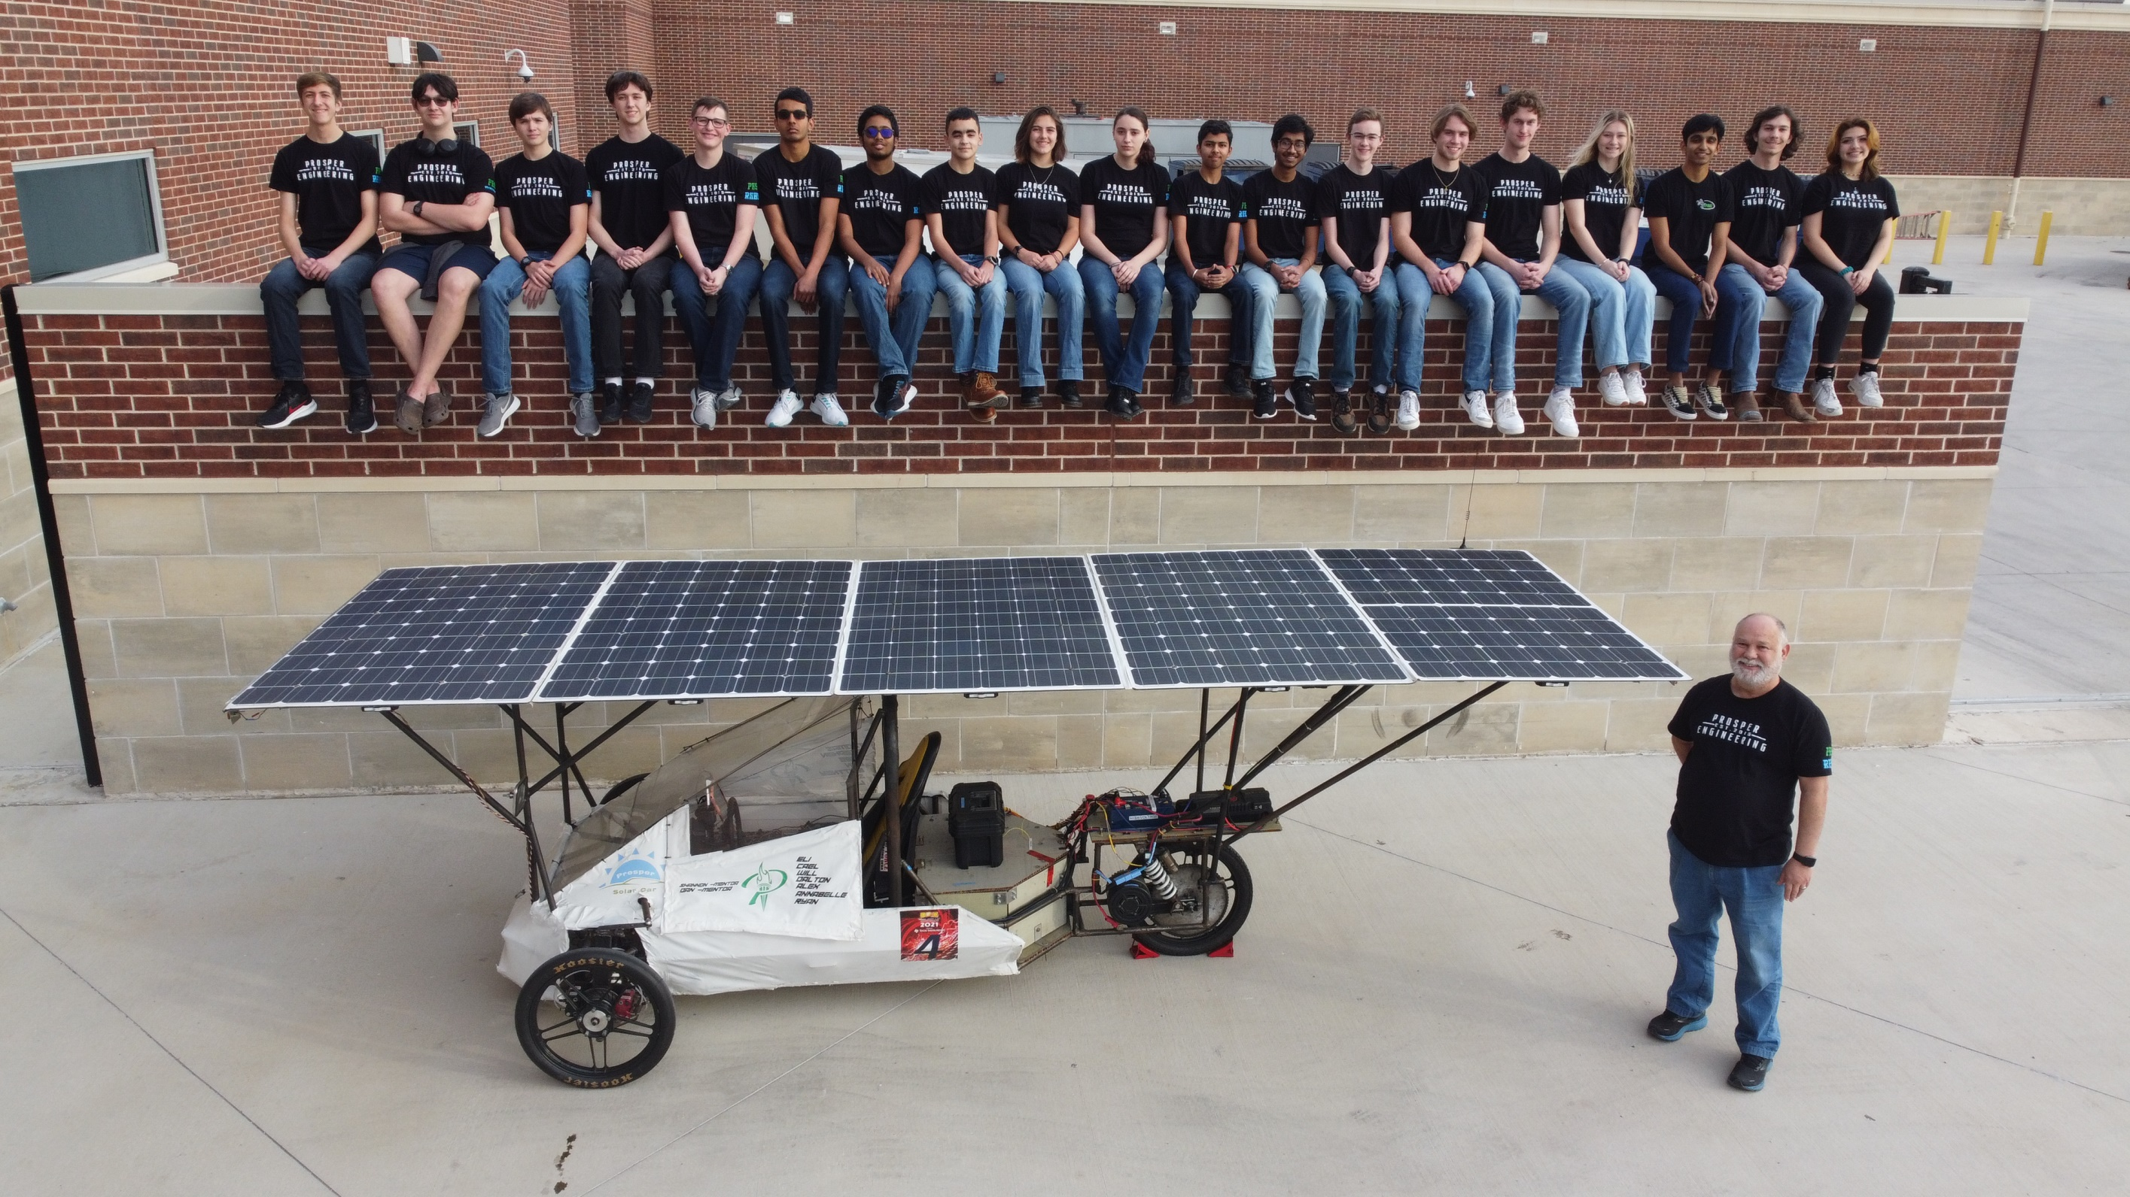

Slide 12
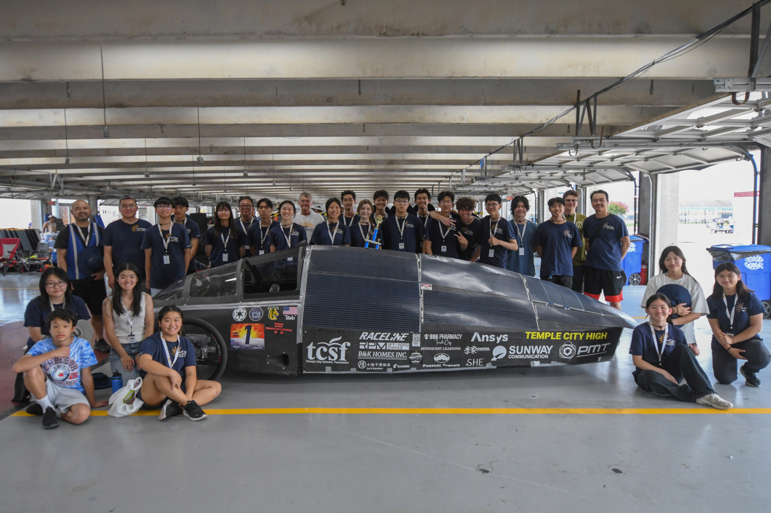

Slide 13
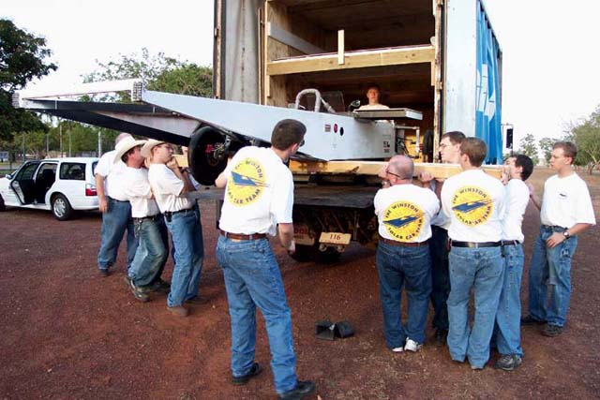
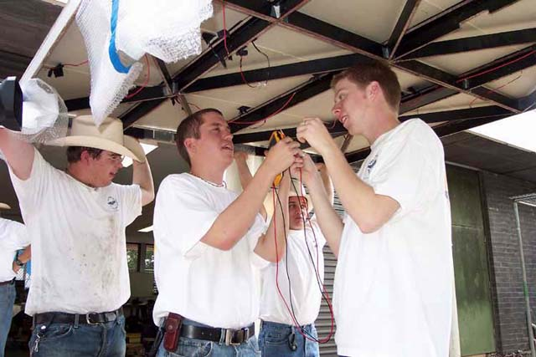
Be sure to have
enough team members to
accomplish the
task involved!

Slide 14
Should teams place a size limit on the Racing Team? (1) For instance, one team in 2024 had 51 participants. Lots of people just standing around. (2) One solution: race more than one solar car! We recommend a team size of 15 team members and advisers.

Slide 15
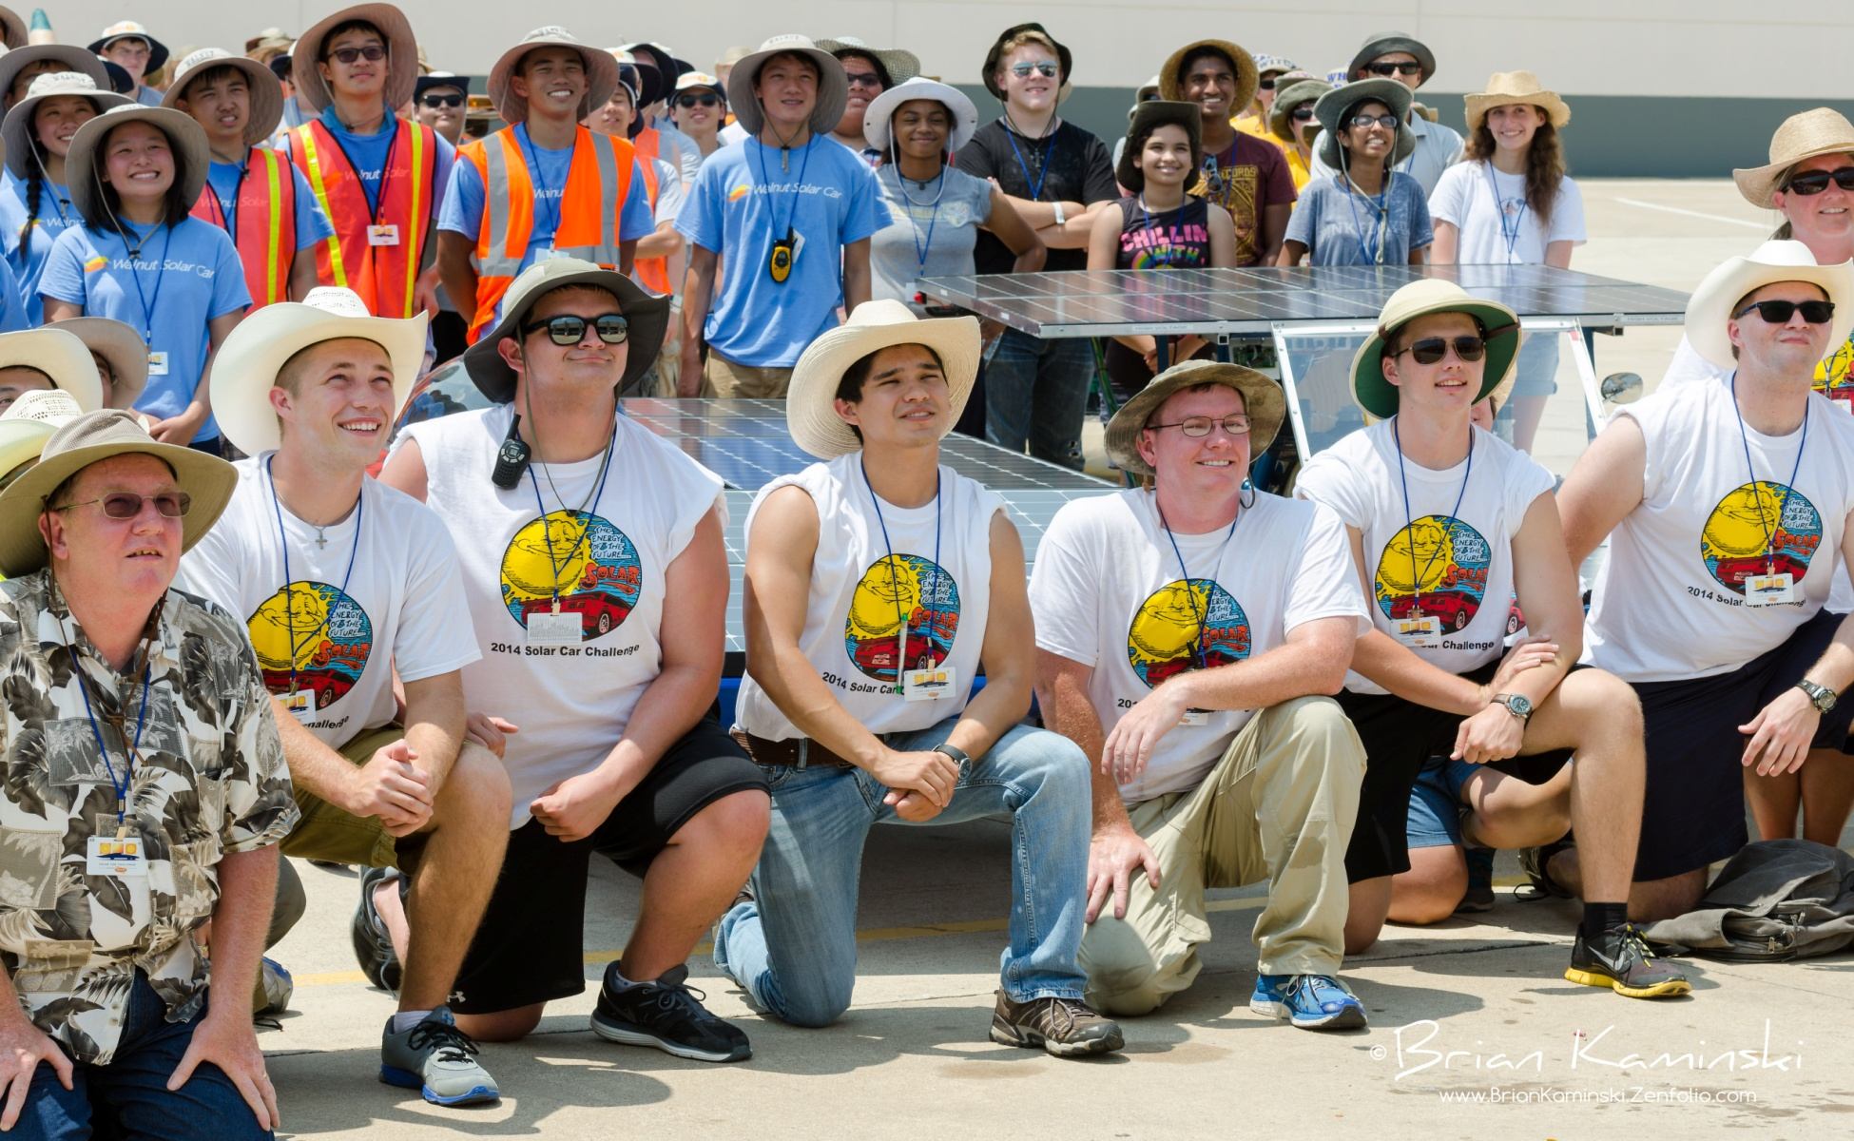
Develop the Role of Team Captain

Slide 16
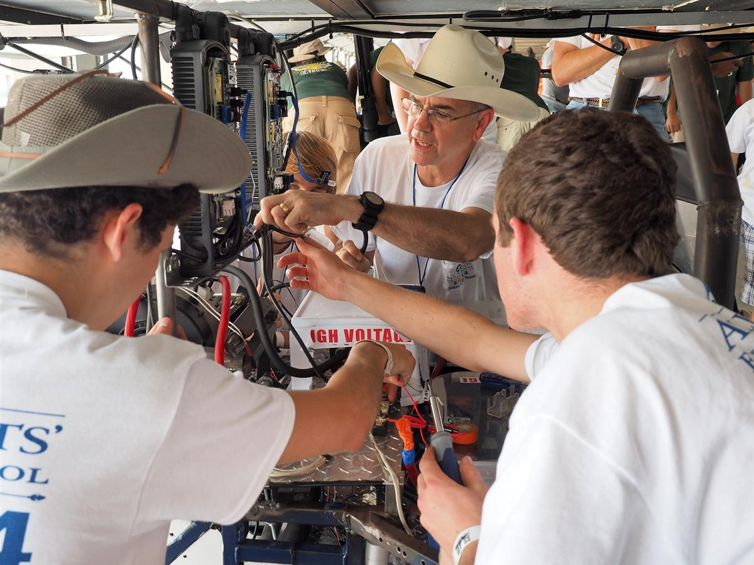
Is the team vested in the project?

Slide 17
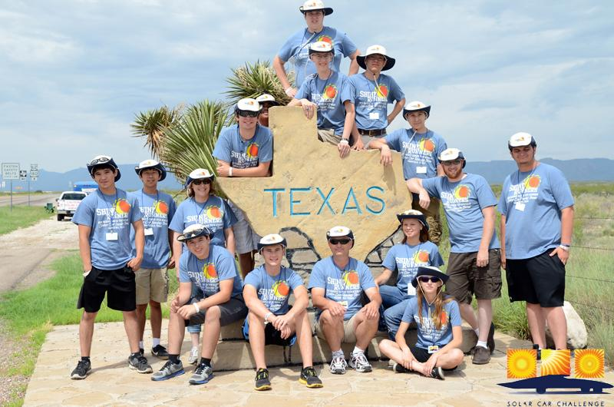
Techniques for developing long term team & parent support

Slide 18
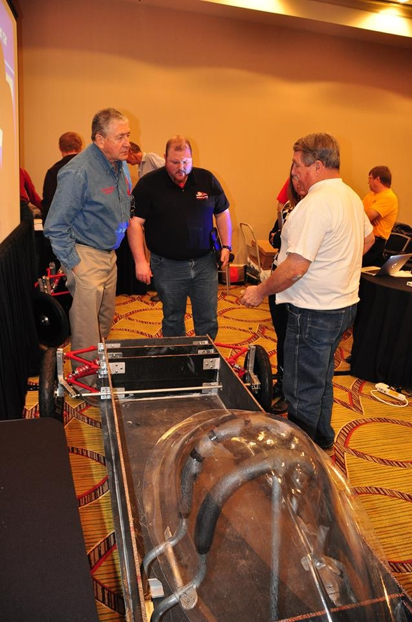
Take Advantage of Webinars
Workshops and Webinars help you plan your project.
Workshops help you learn the skills to build a roadworthy solar car.
Each team finds its own solution to the problem: building a roadworthy solar car.
Specialty Workshop helps you refine you skills and improve construction techniques.

Slide 19
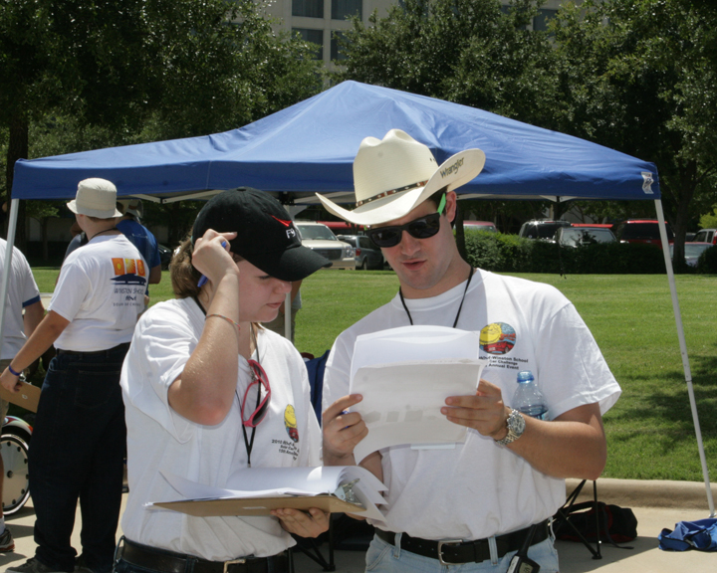
Read the Rules Together (many times)

Slide 20
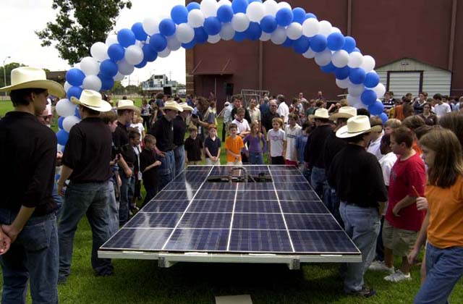
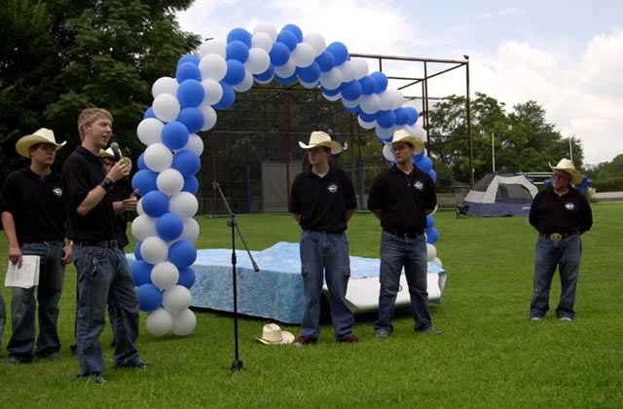
The importance of the Team being a part of fundraising

Slide 21
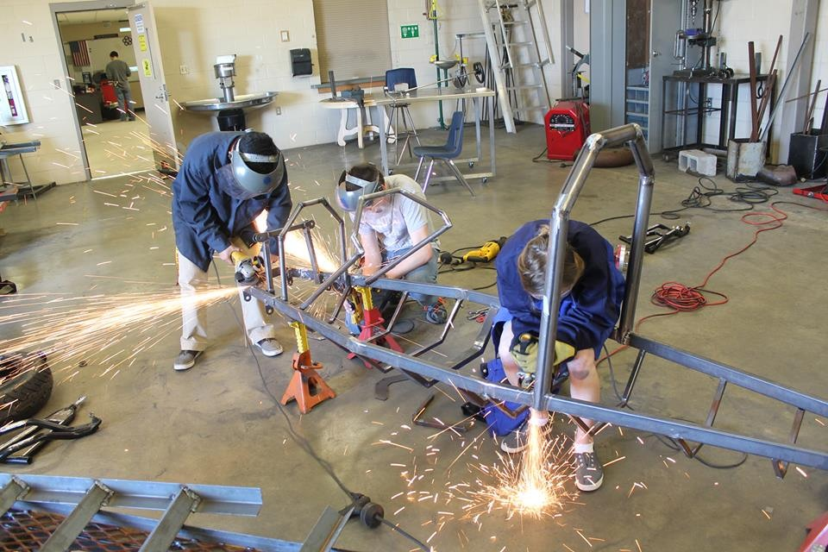
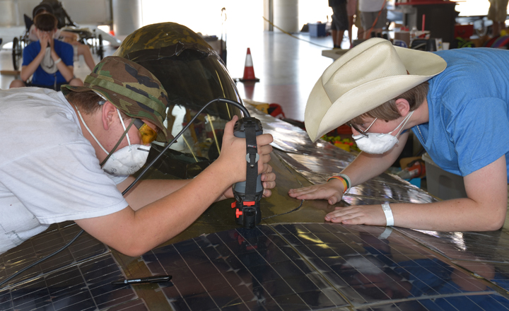
The importance of building skills

Slide 22
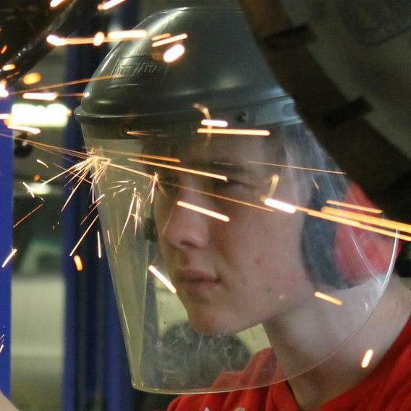

Slide 23
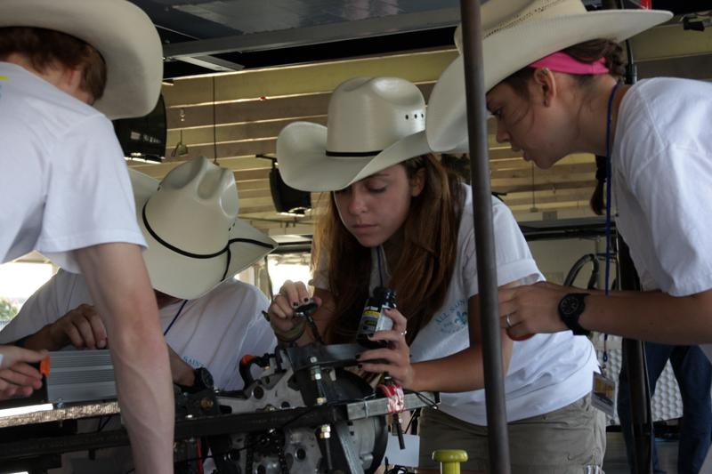

Slide 24
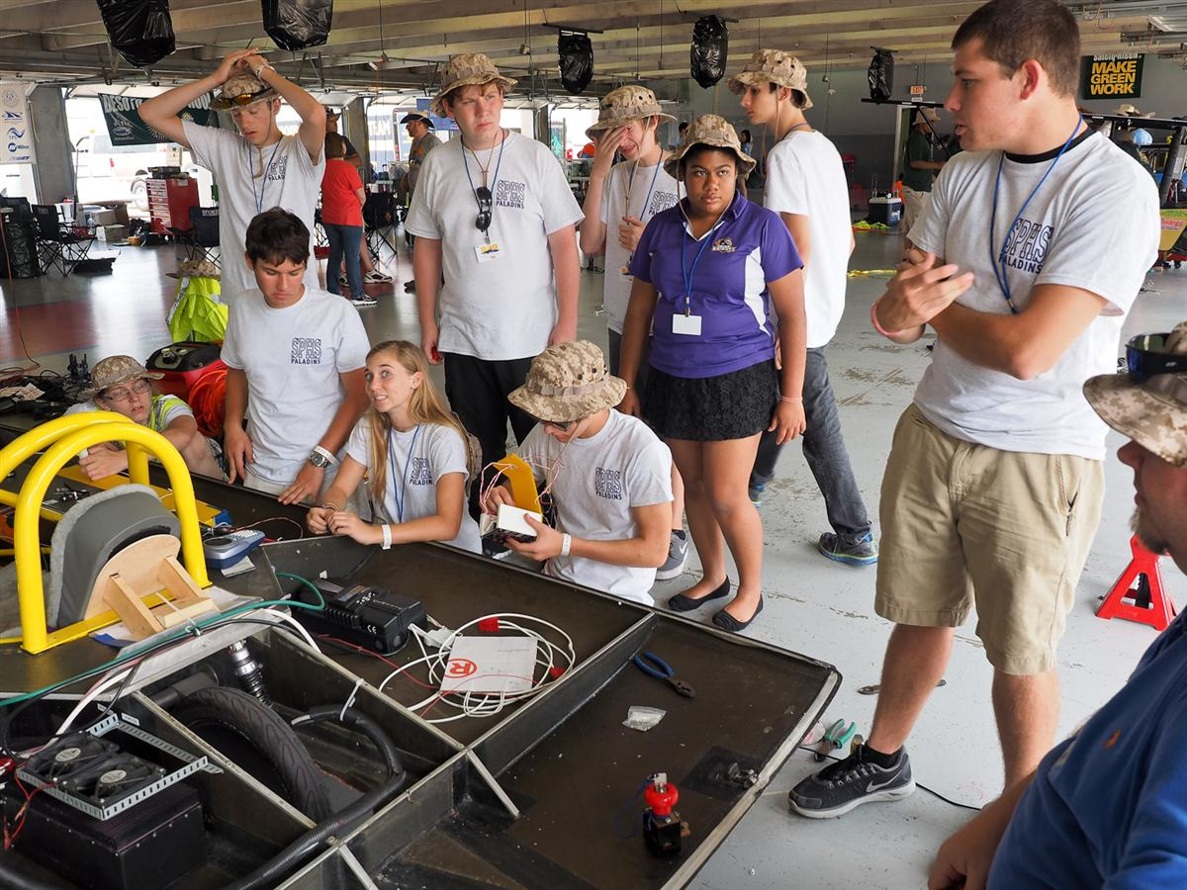
Importance of Goal-Setting and following a Timeline

Slide 25
TIMELINE
Plan Develop Fundraising Buy Build Re-Engineer Test Race Post And Promo Car Race
Design Materials Eval
____________________________________________
Sept Early Oct Oct Nov Dec - Mar Apr - May July Aug

Slide 26
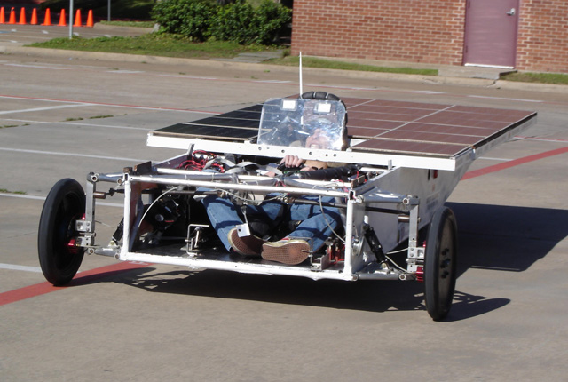
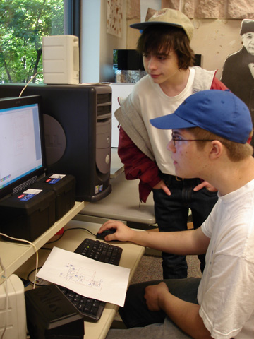
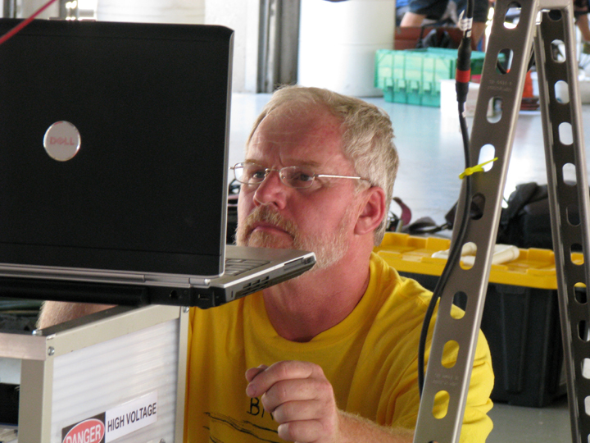
Importance of Testing

Slide 27
The Reality of Testing
The three Teams that did not pass Scrutineering in 2024 never tested their vehicles before arriving at the race.
Recommendation: Put 500 miles on your solar car before you ever get to the Race. You want to “break” you car at home . . not at the race.
Please don’t show up at the race with an incomplete solar car!

Slide 28
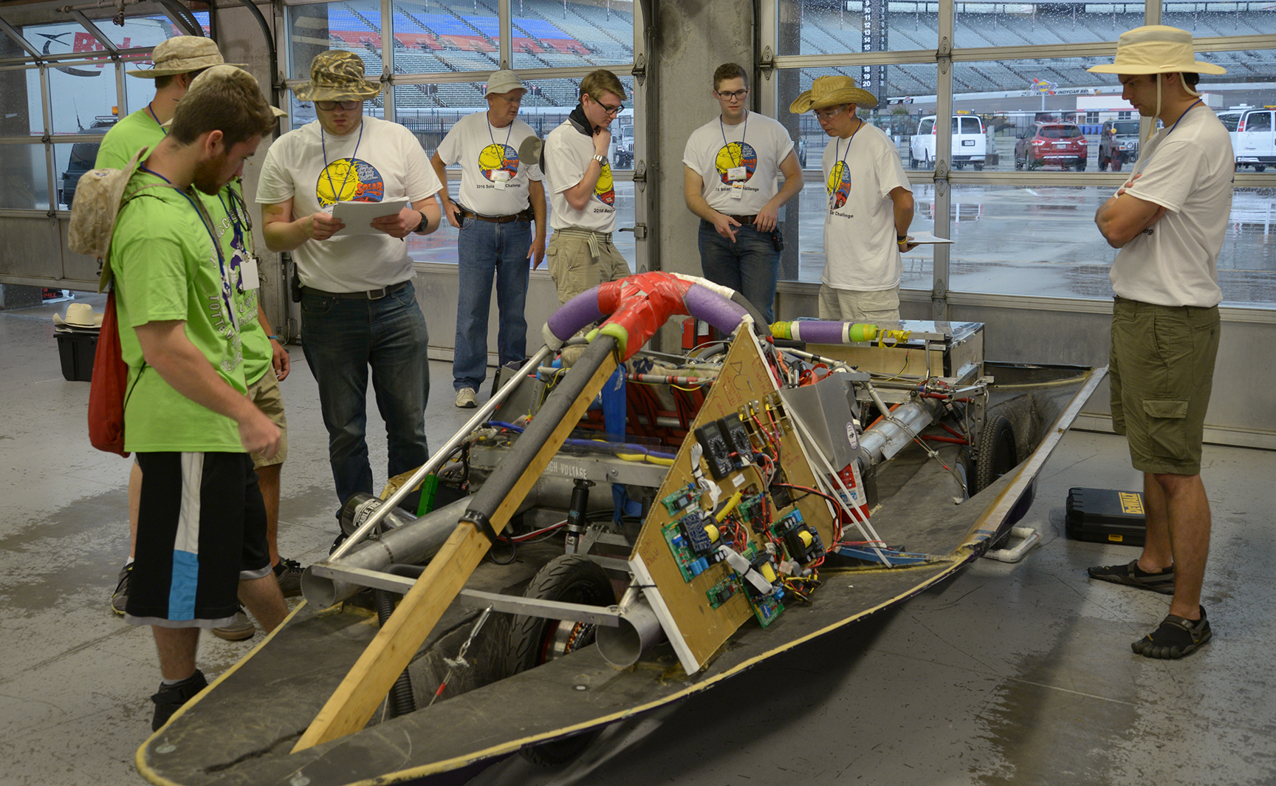
Focus on preparing for SCRUTINEERING

Slide 29
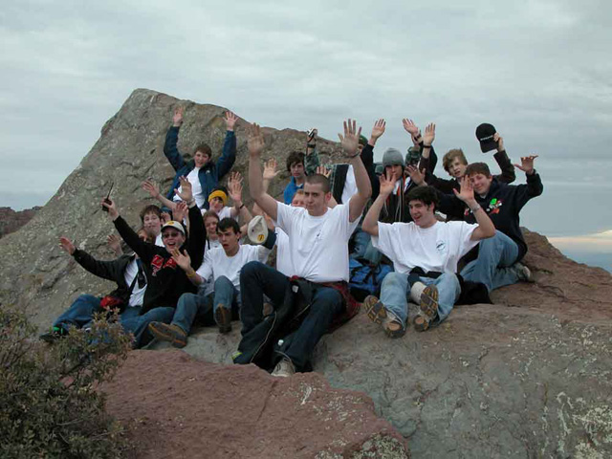
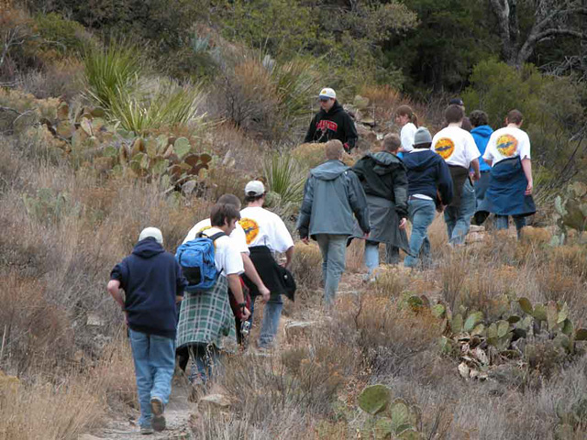
Post-Race Evaluation

Slide 30
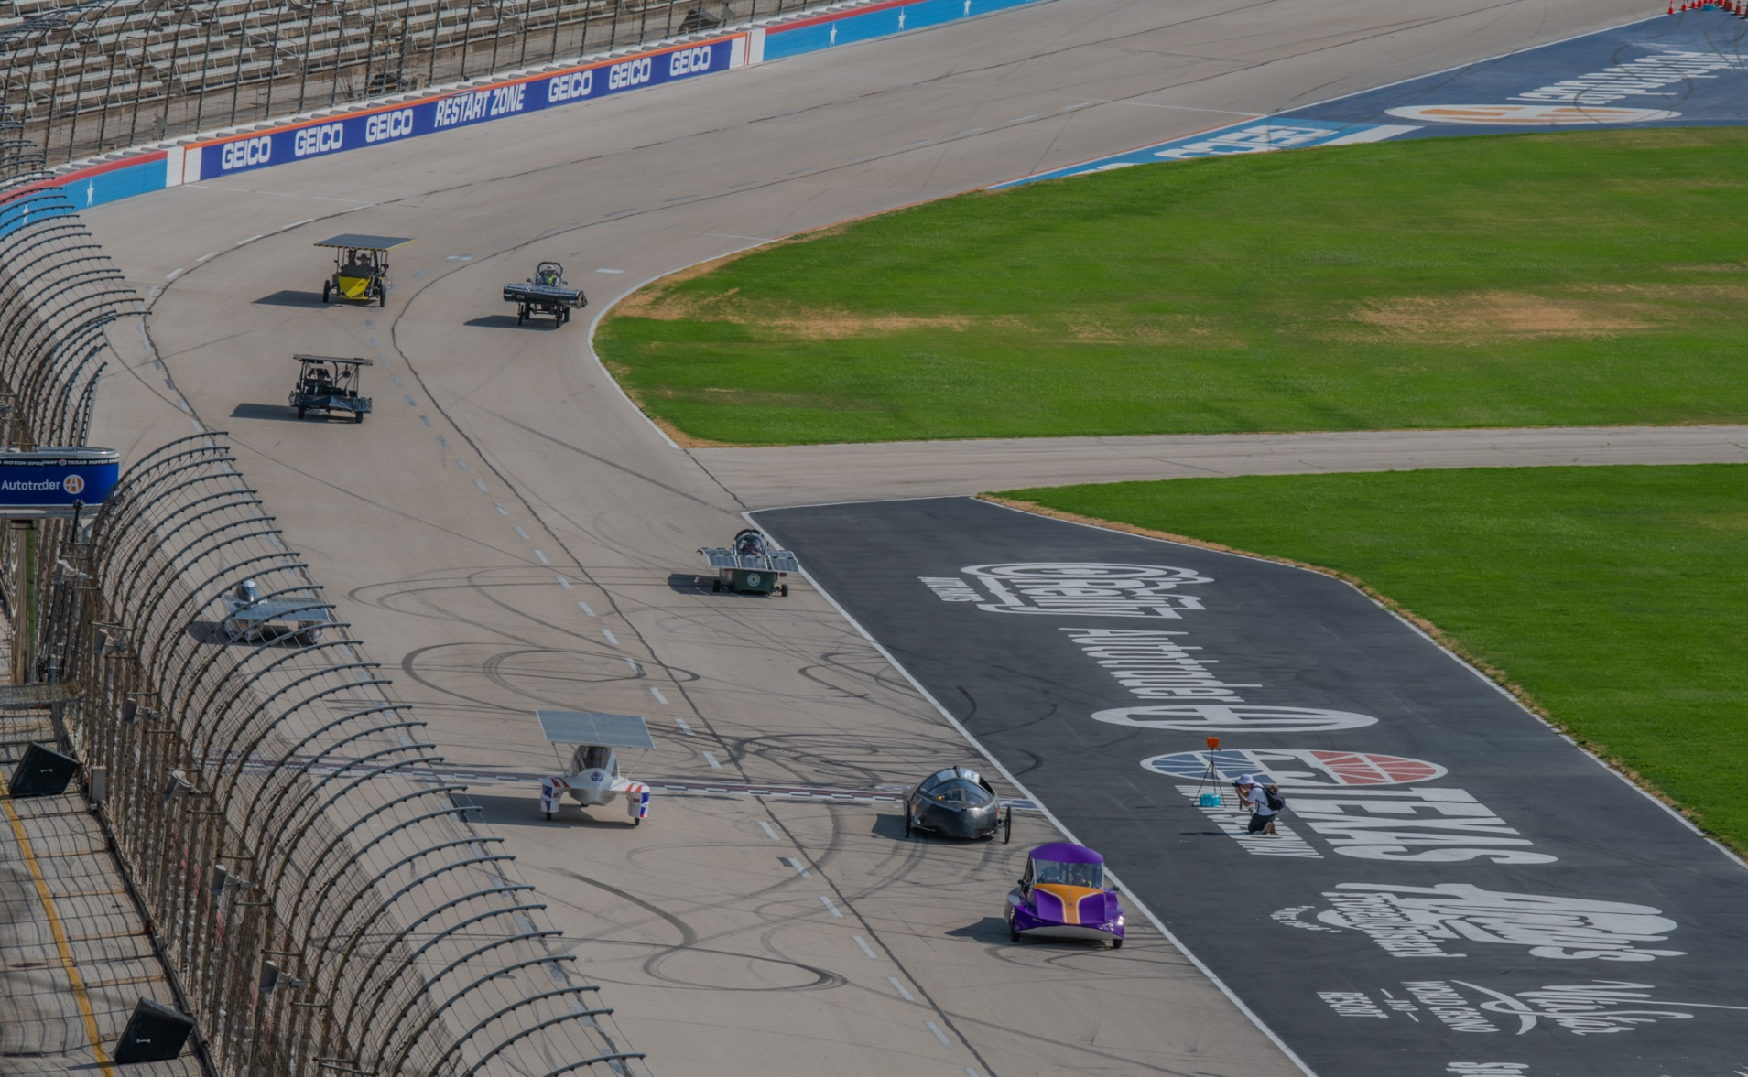
IS IT WORKING?

Slide 31
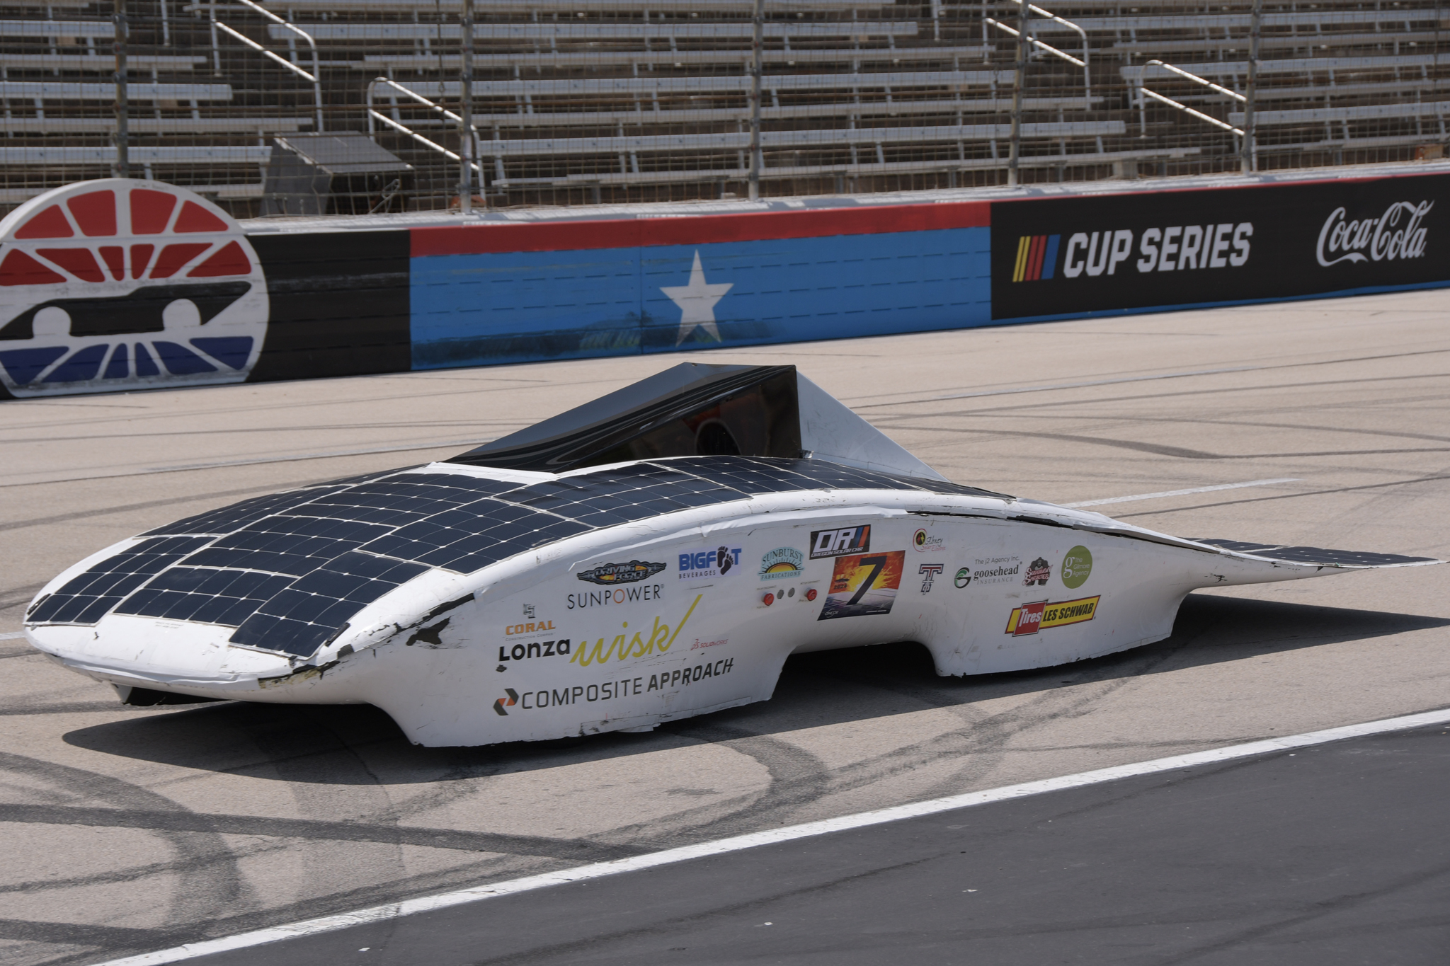

Slide 32
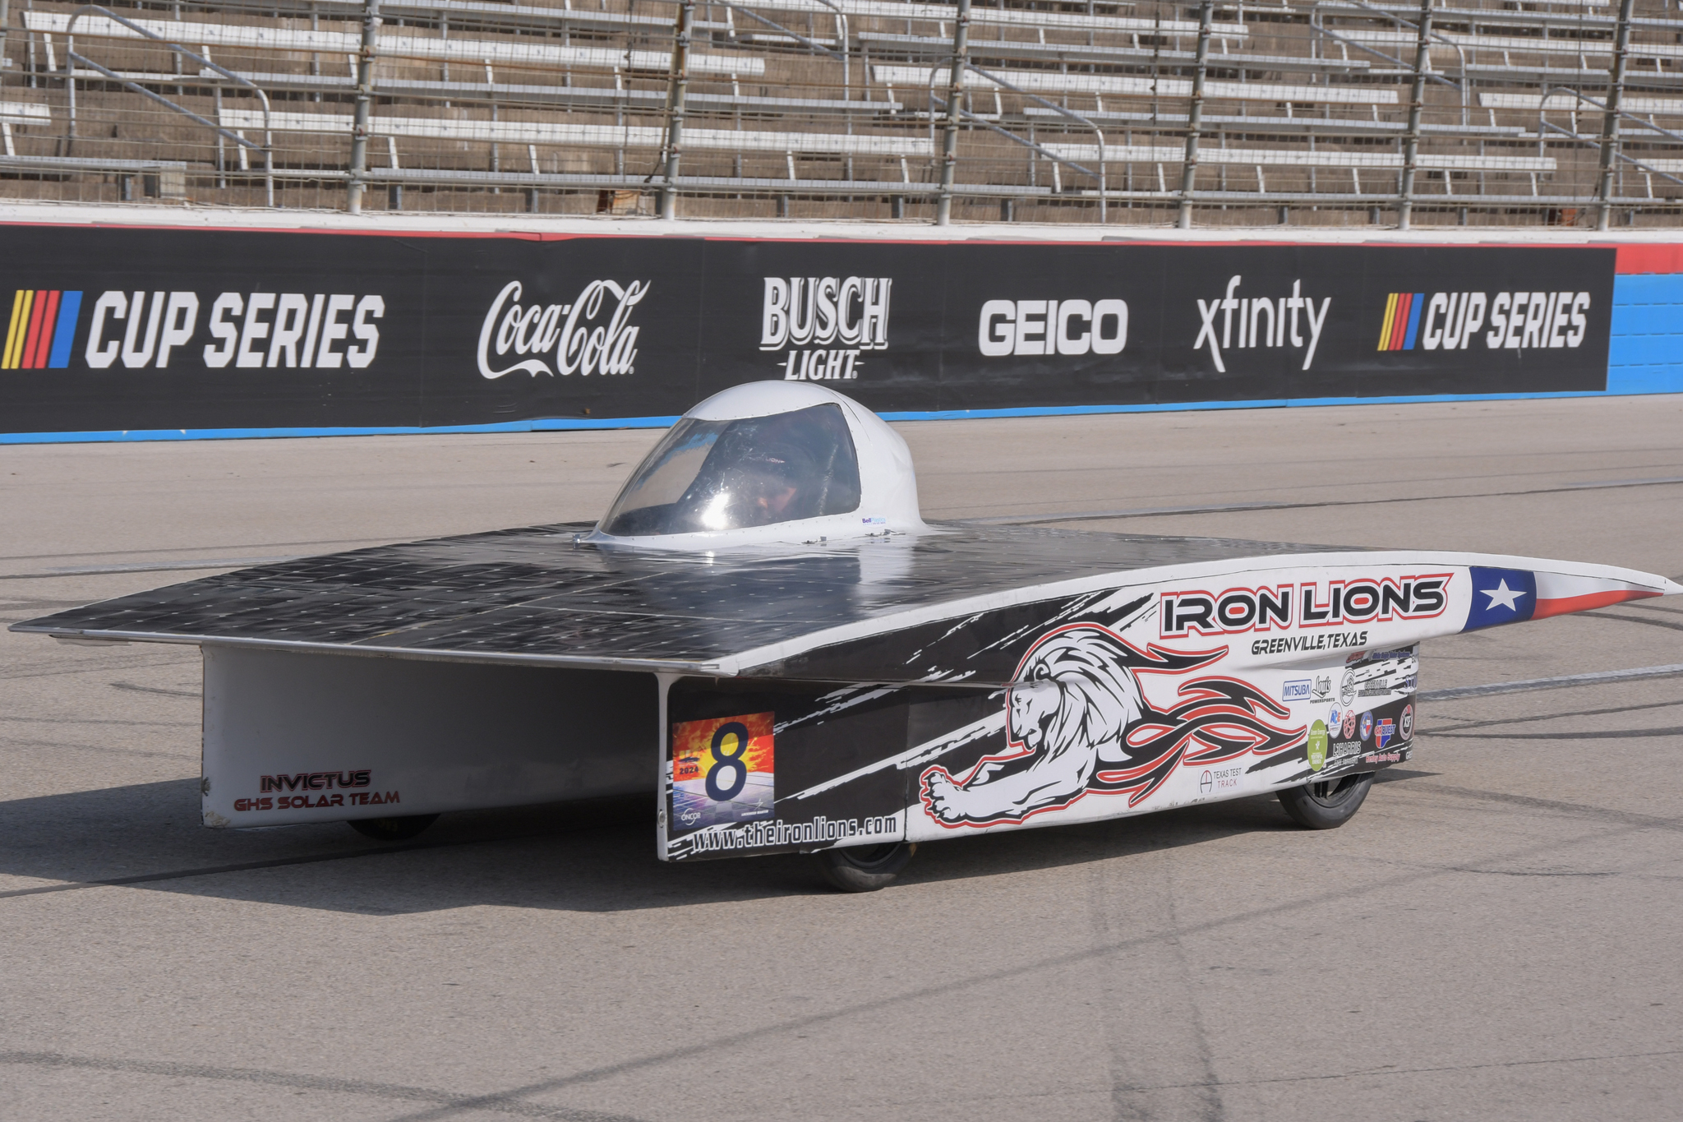

Slide 33
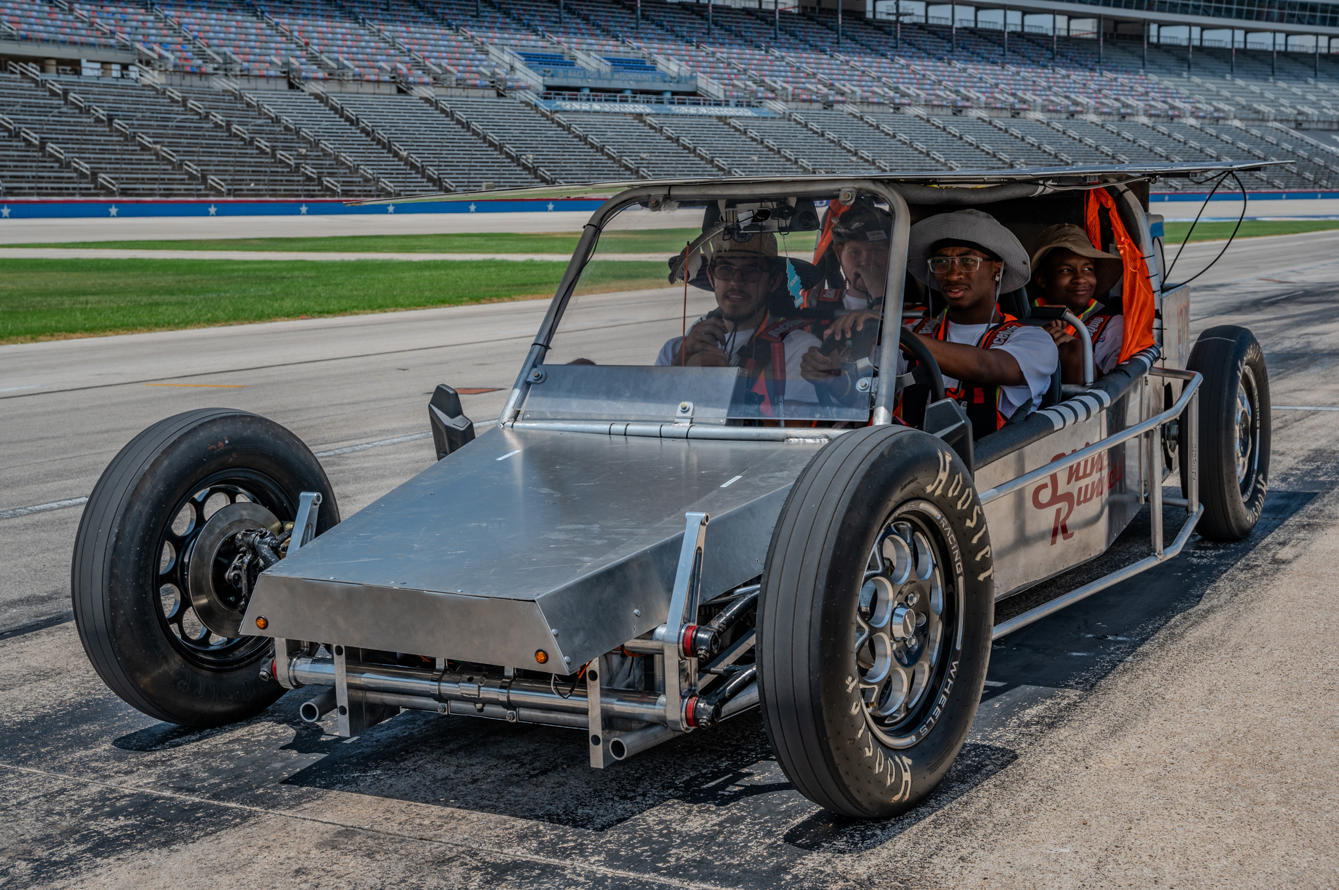

Slide 34
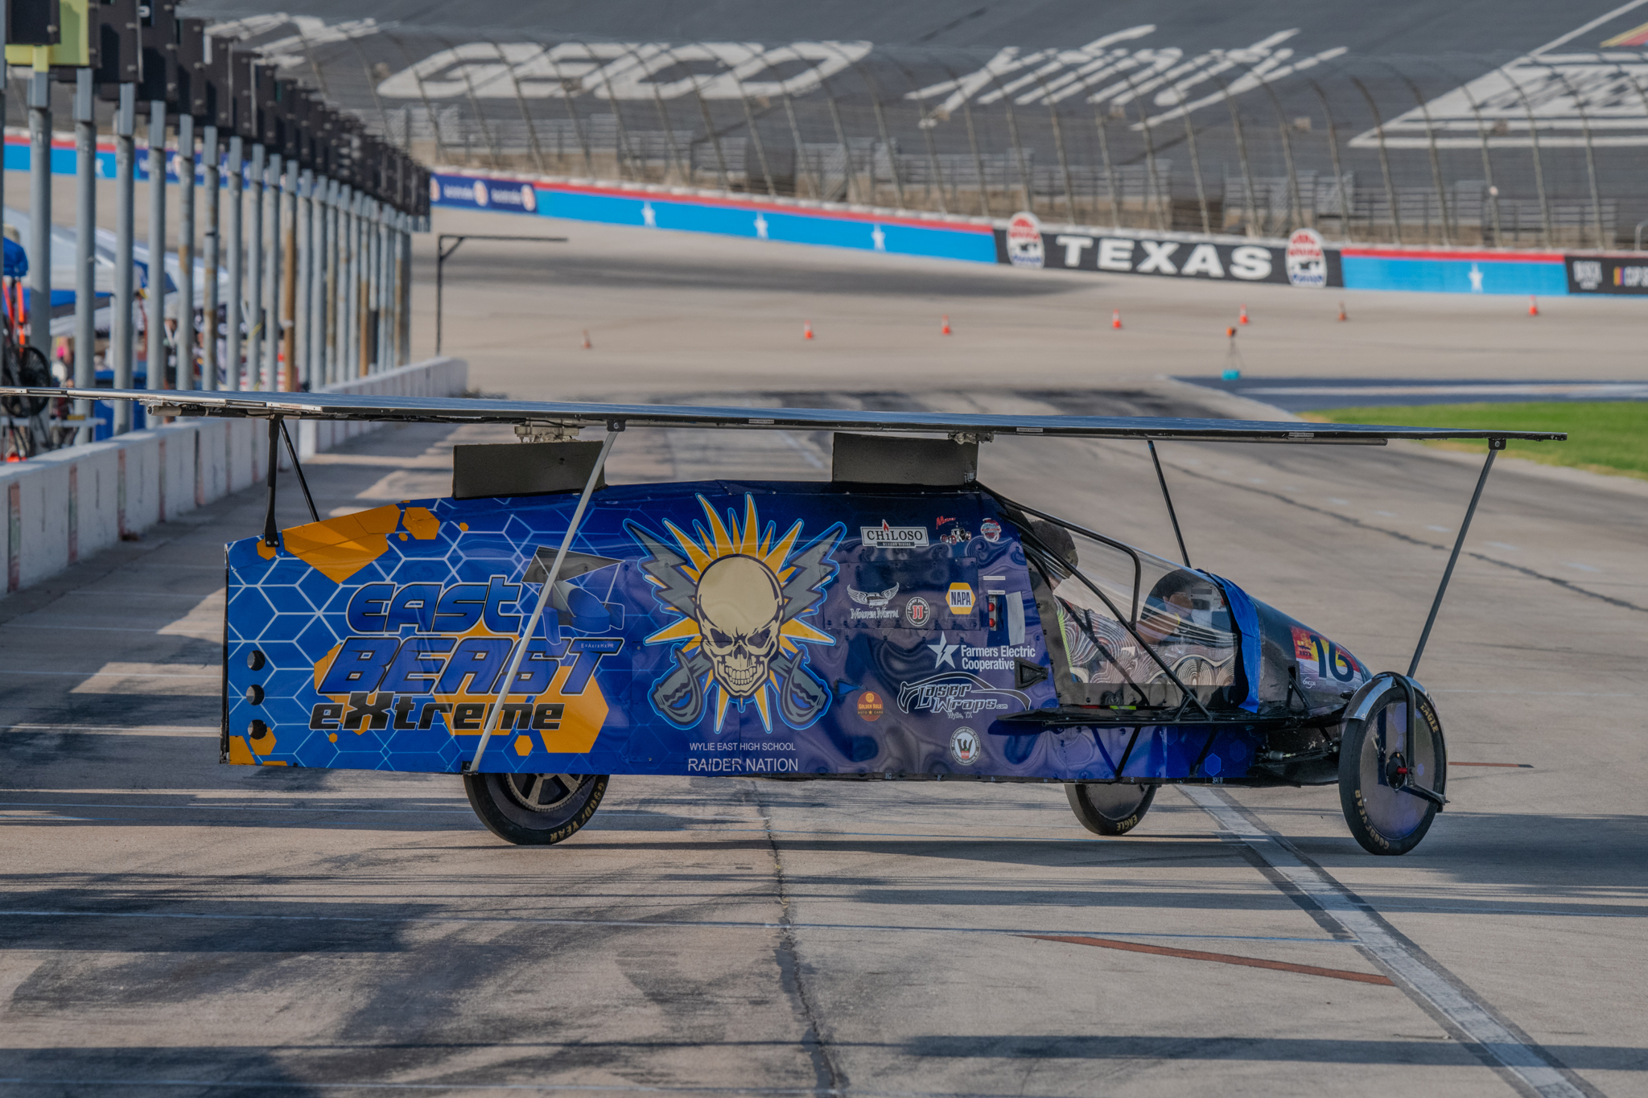

Slide 35
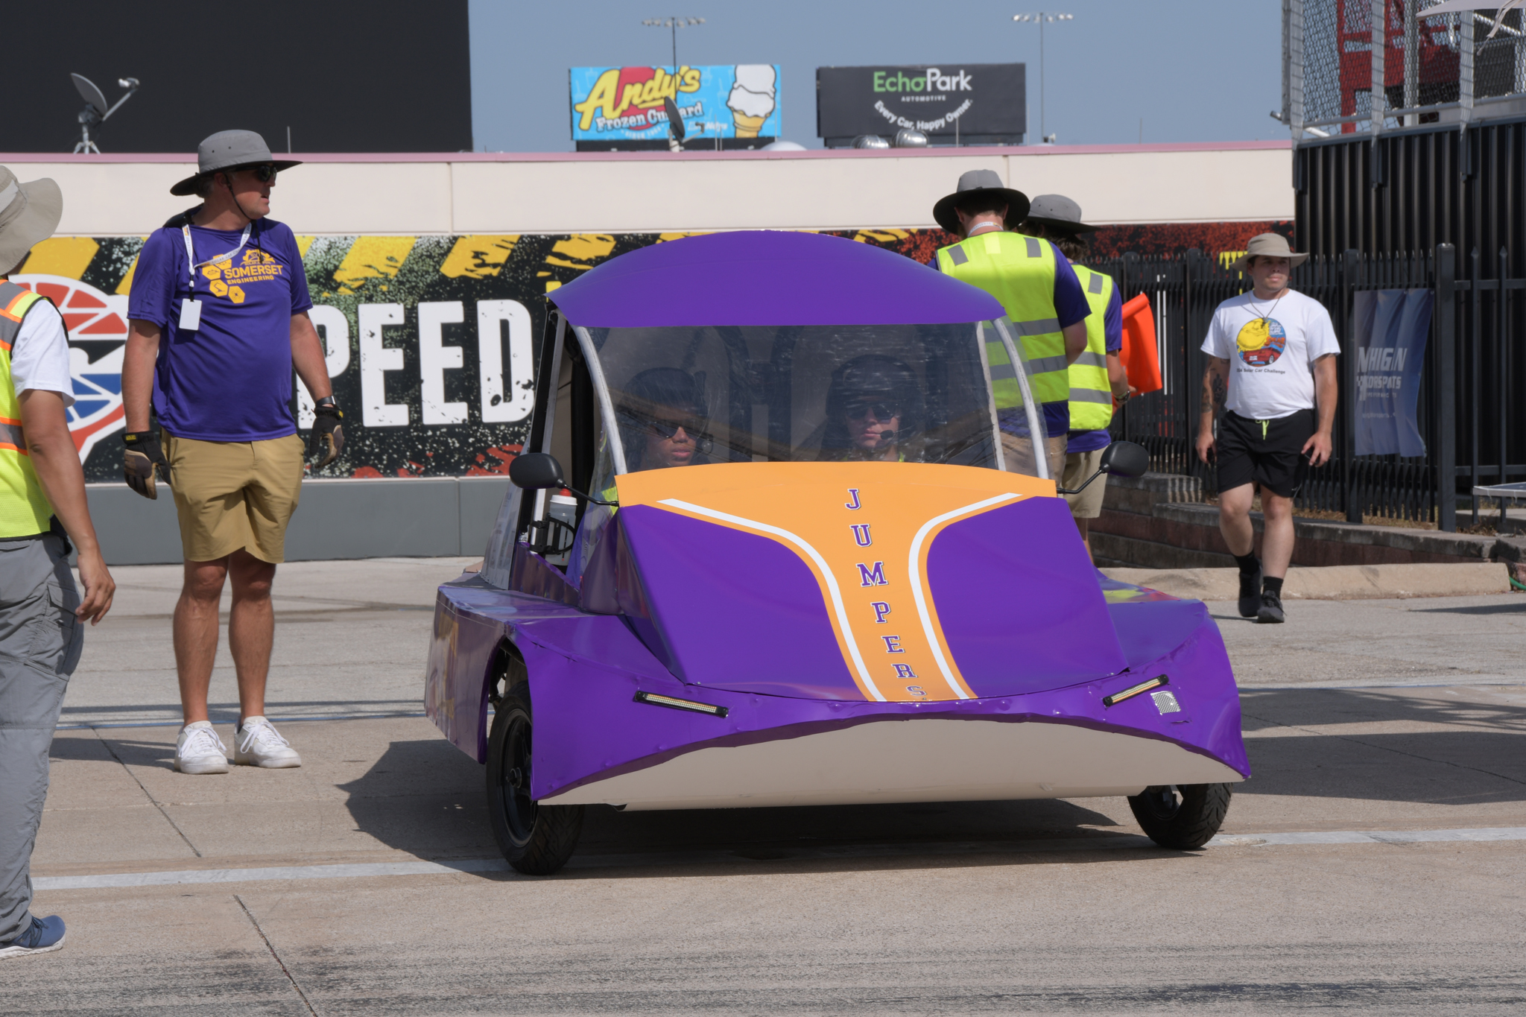

Slide 36
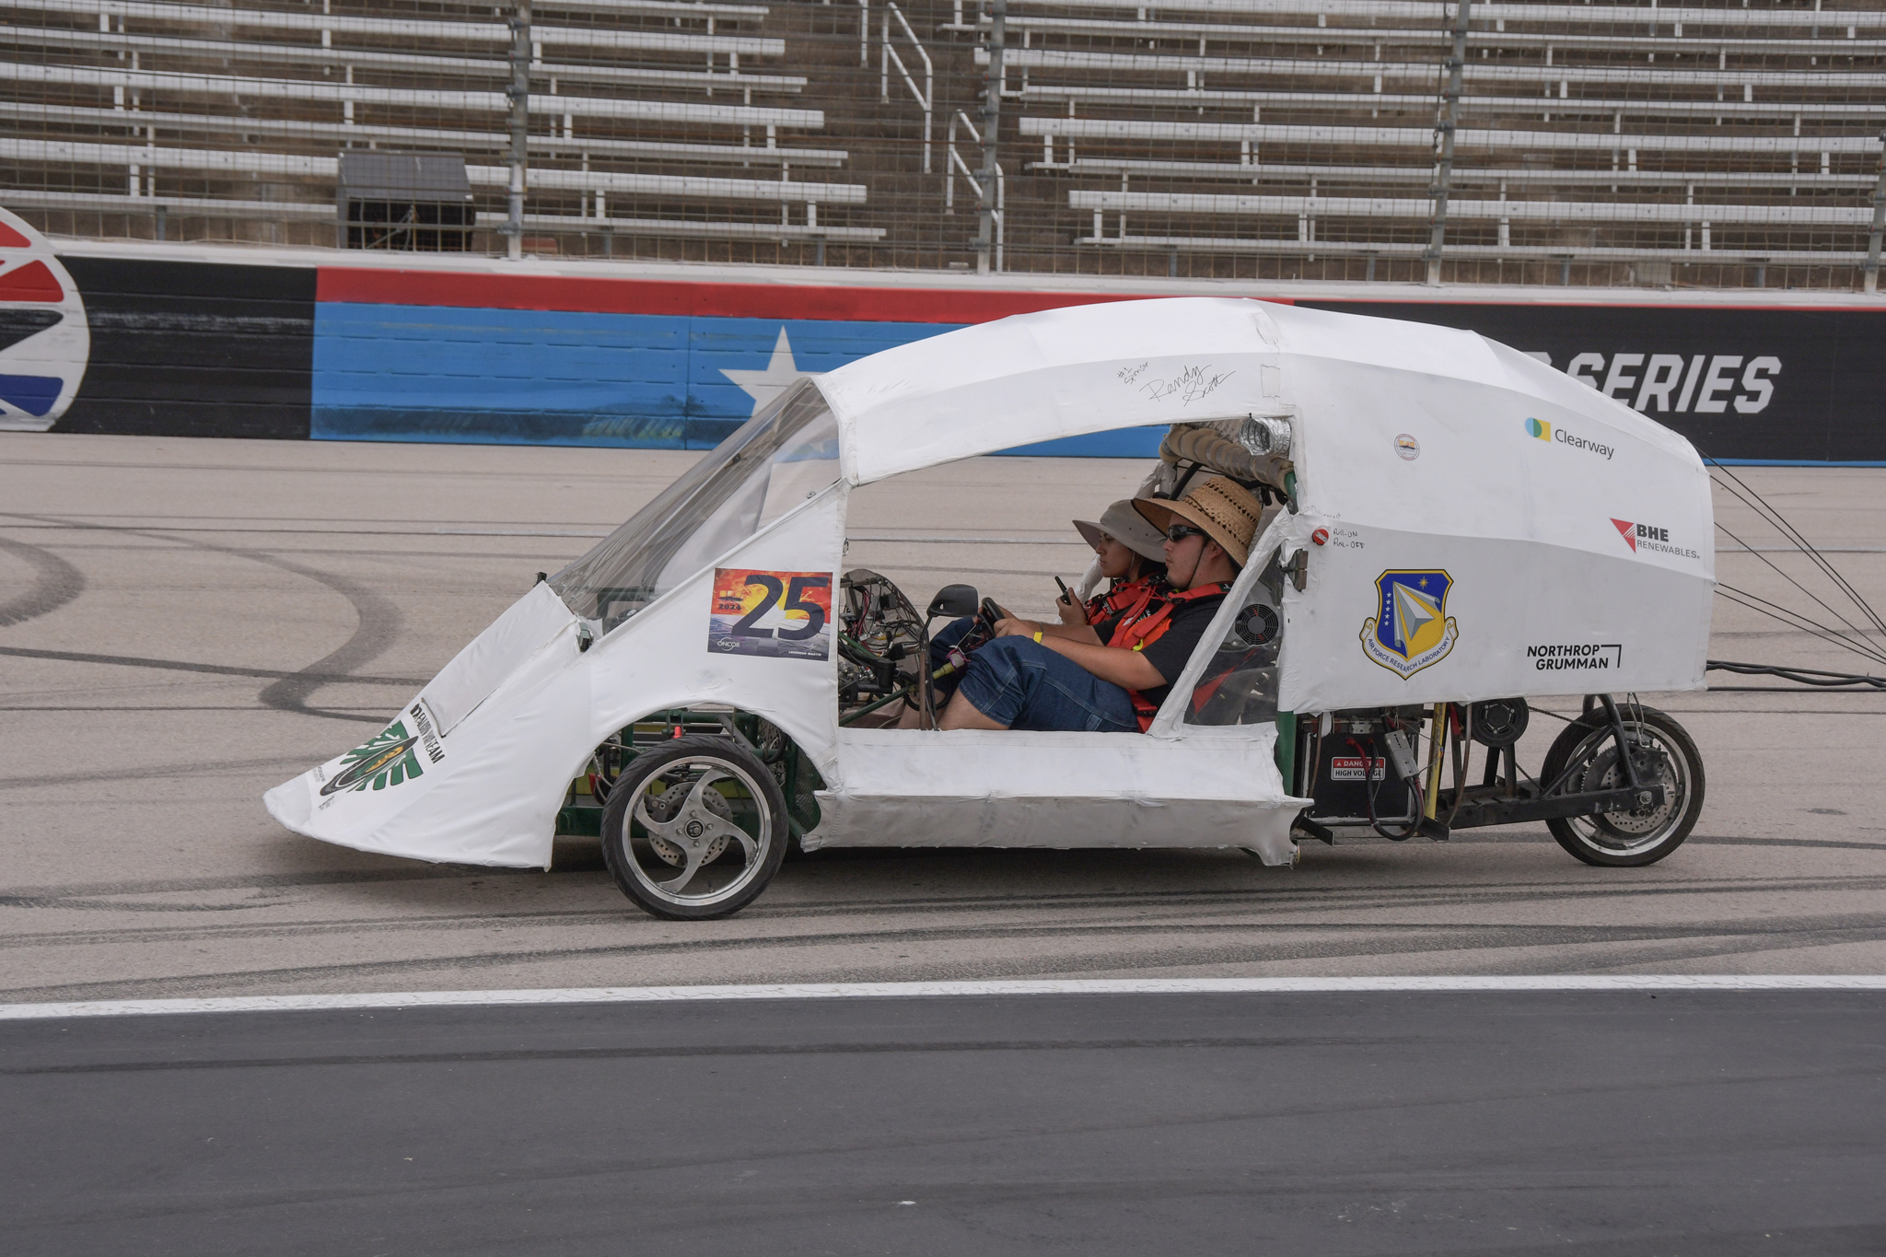

Slide 37
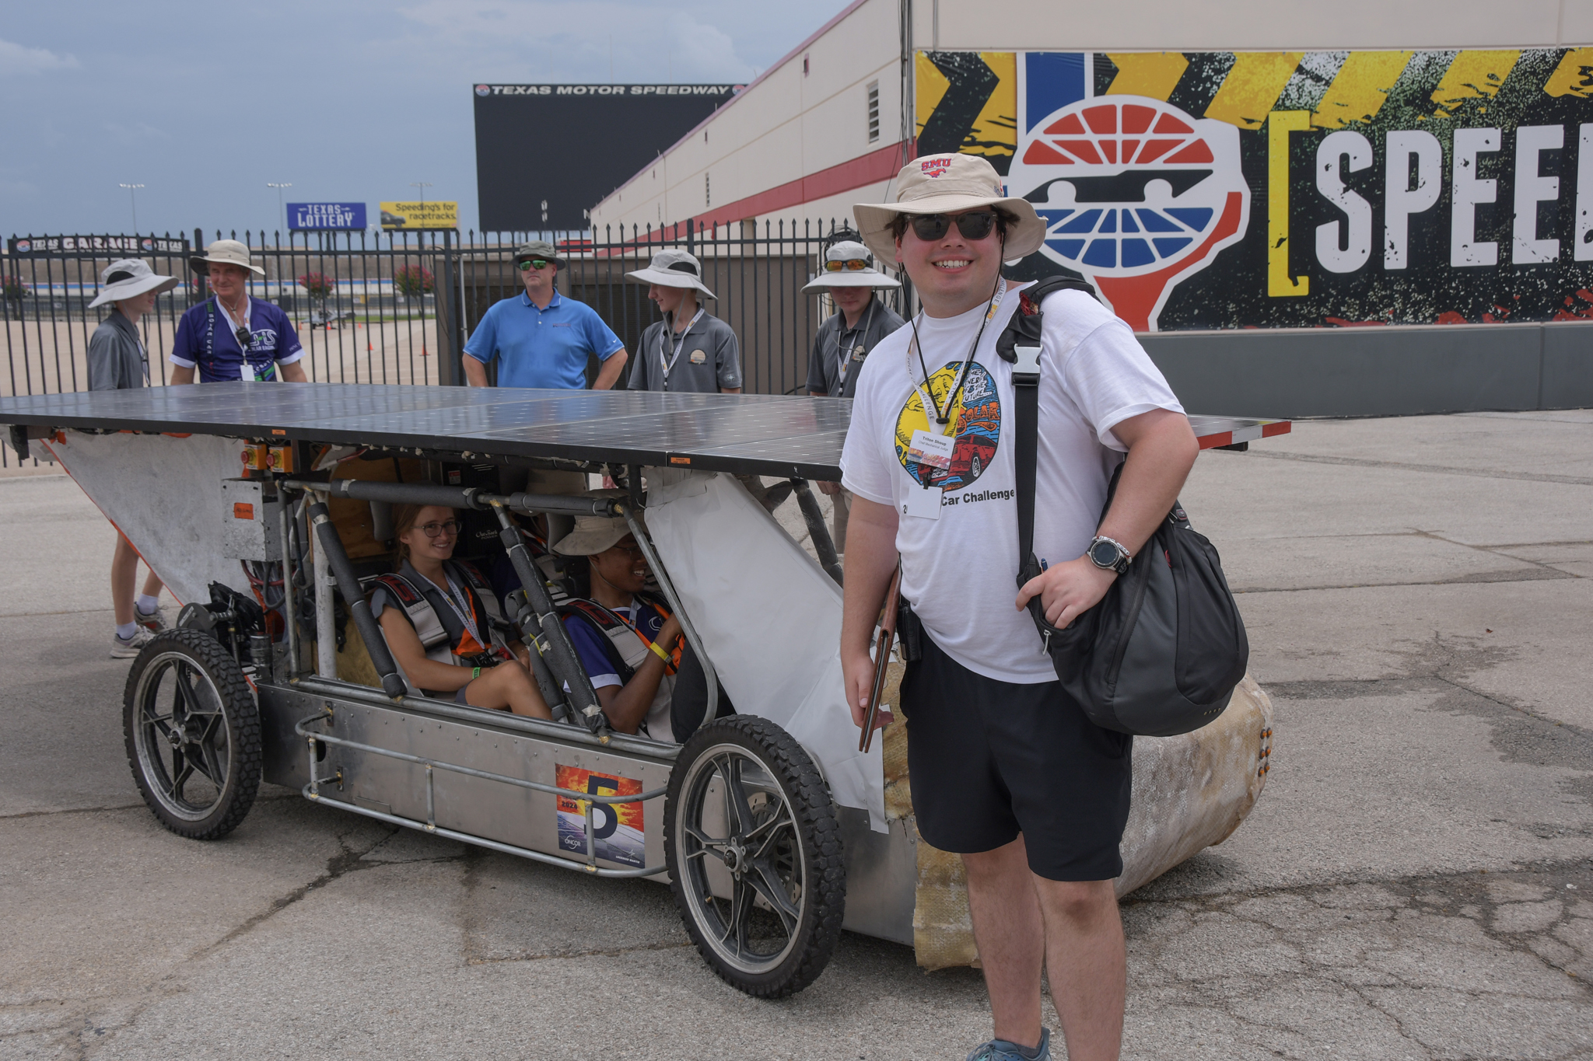

Slide 38
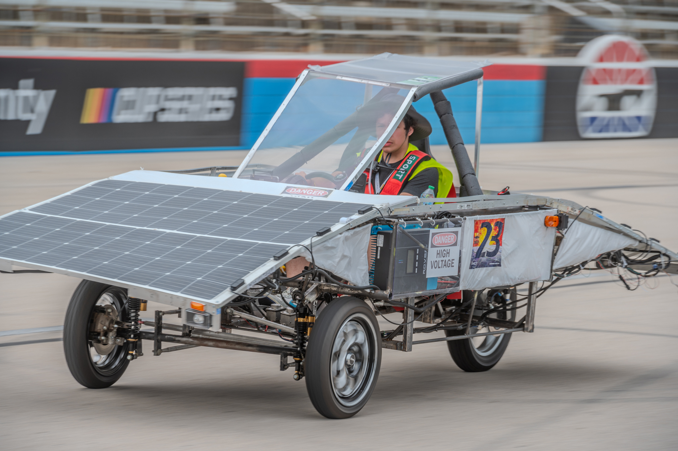

Slide 39
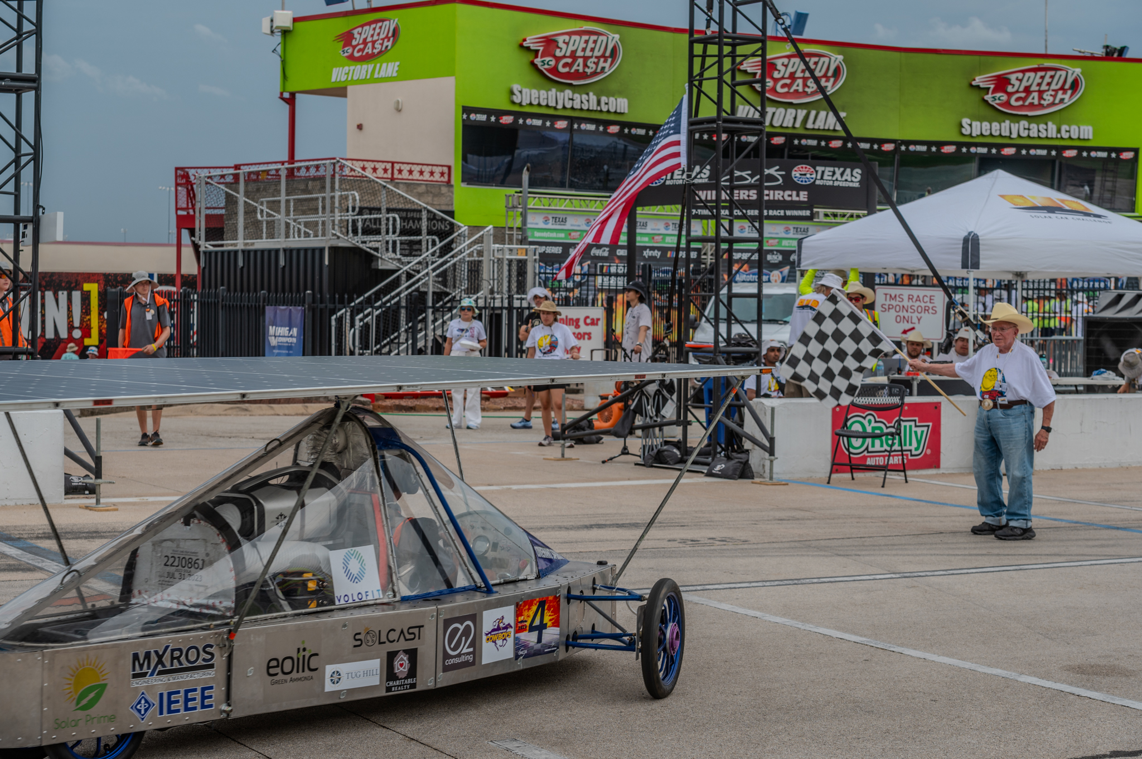

Slide 40
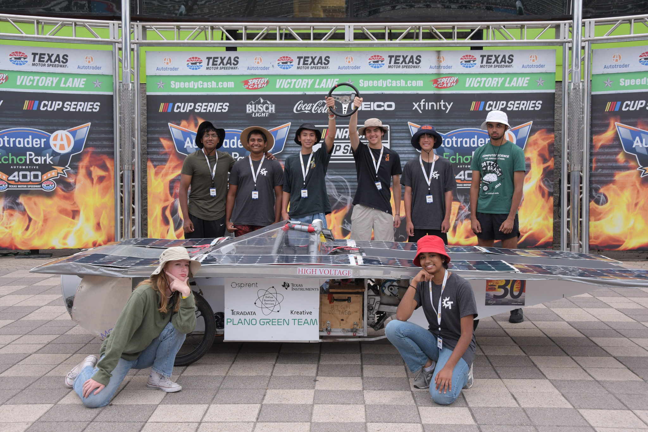

Slide 41
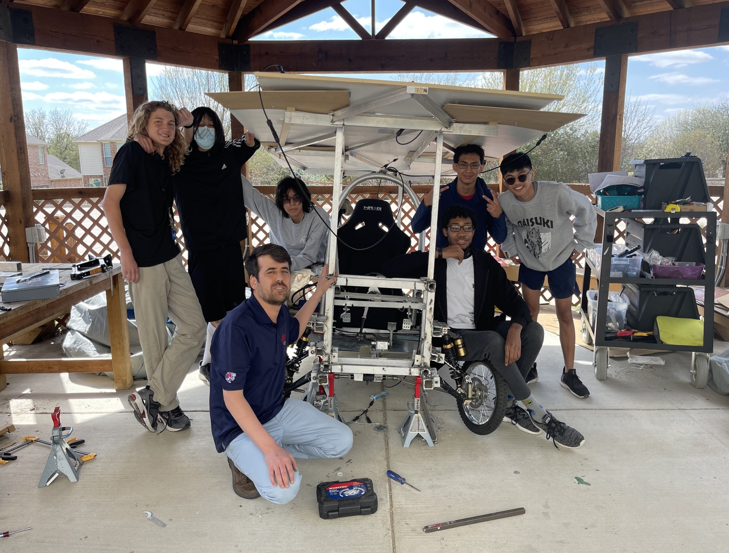

Slide 42
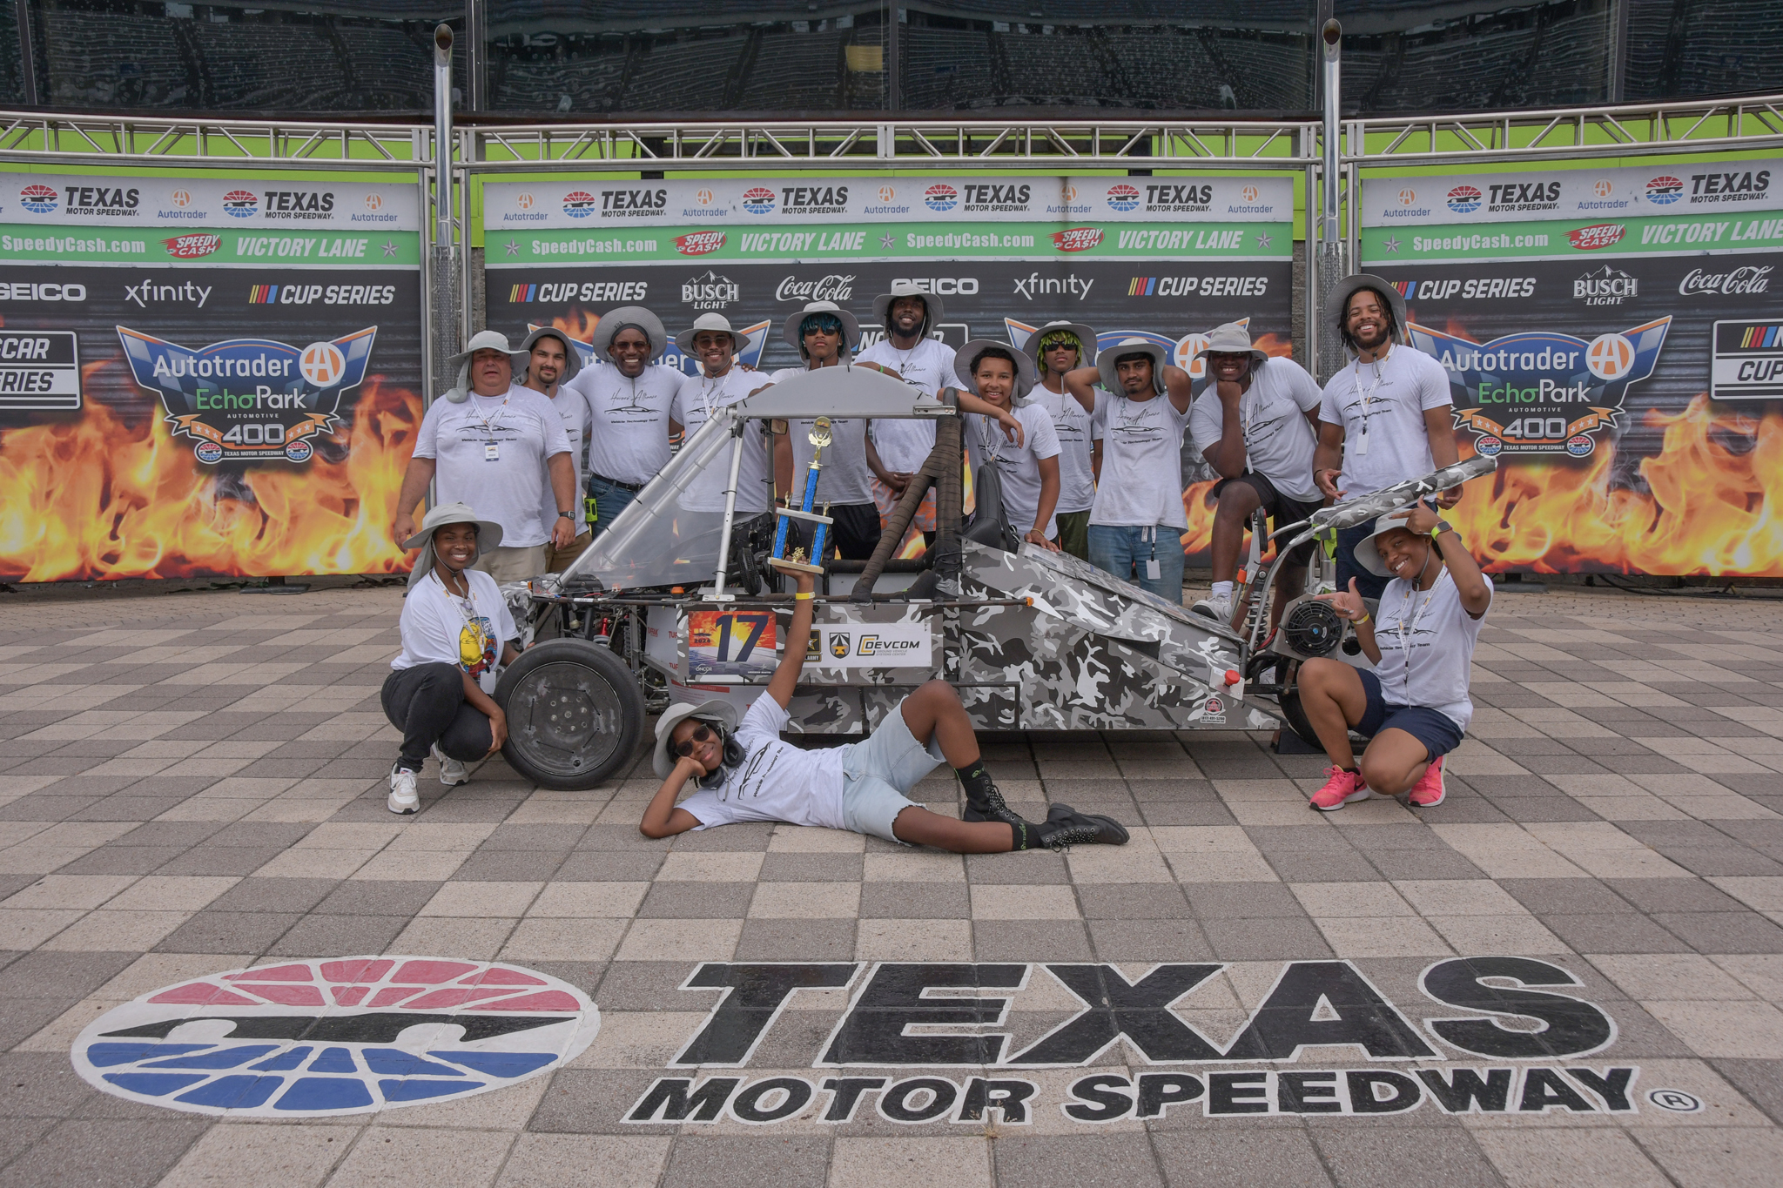

Slide 43
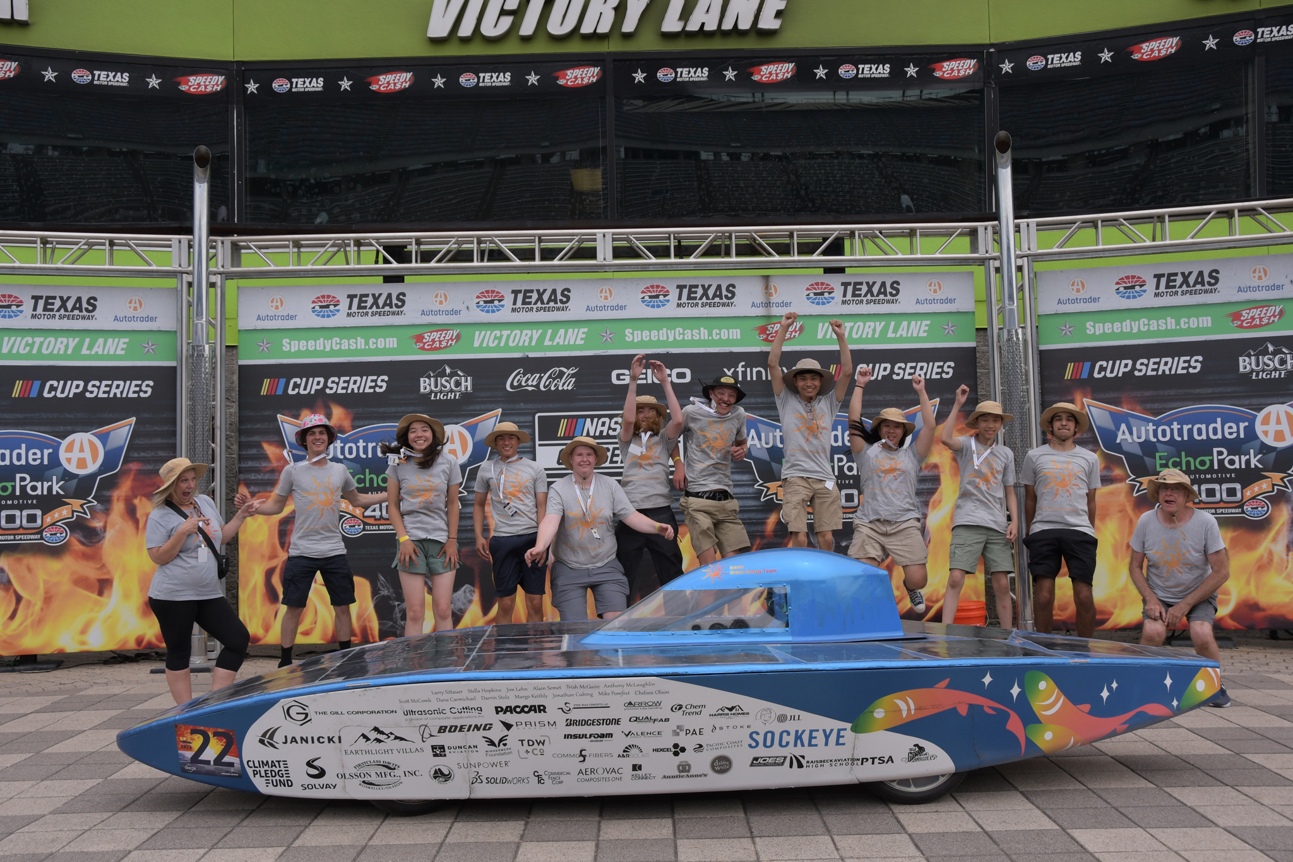
YES . . . BY 23%

